Slide 1
Lecture 4, part 2

Slide 2
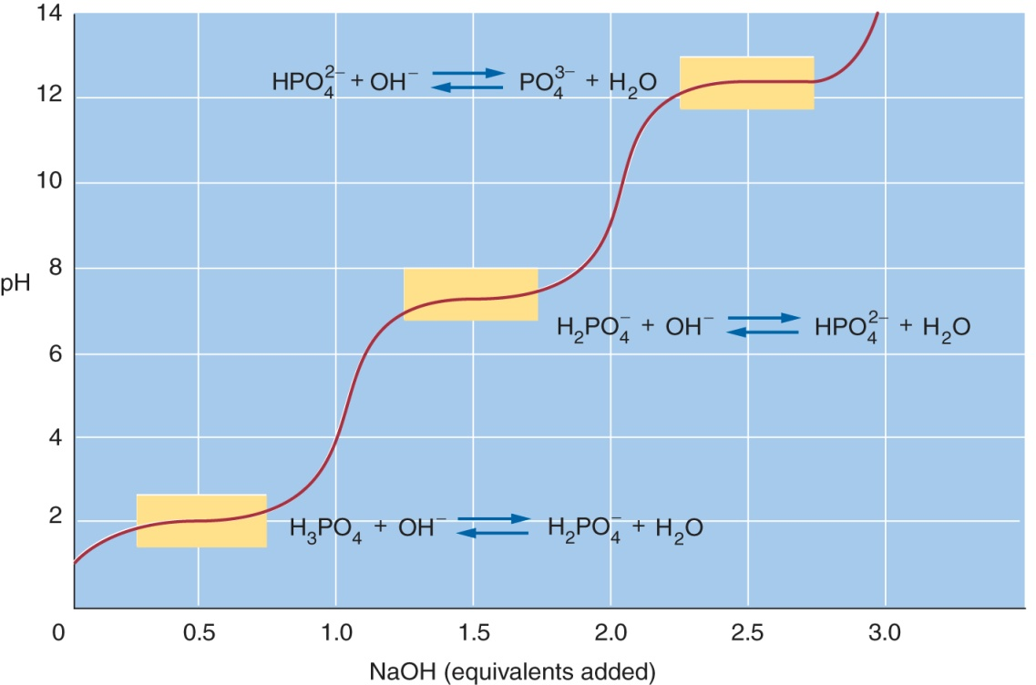
Intracellular pH is usually near 7.2
Use a weak acid buffer for which the pK_{a} is within 1 unit of 7.2
  (look at this again →)
Inside cells typically buffered by phosphate:
  H₂PO₄ → HPO₄²⁻; pK’_{a} = 6.7
  (pK’_{a} is measured at a reasonable biological temperature)

Slide 3

Blood serum pH is 7.4 ± 0.05

Slide 4
Bicarbonate buffer
In the blood serum, the phosphate concentration is low so that cannot be the buffer
Consider the following series of equilibria:
The bicarbonate anion (HCO₃⁻) is the most important buffer of blood serum

Slide 5
Bicarbonate buffer
The reaction:
CO₂ + H₂O → H₂CO₃ (+ H₂O) → HCO₃⁻ + H₃O⁺
  Is rapidly catalyzed by an enzyme which skips the middle reaction (i.e., no actual H₂CO₃ is formed)
So the two forms of bicarbonate buffer in the serum are CO₂ (aq) (the acidic form) AND HCO₃⁻ (the basic form)

Slide 6
Bicarbonate Buffer
CO₂ (aq) (the acidic form) AND HCO₃⁻ (the basic form) together make up serum bicarbonate buffer
The pK’a for this equilibrium is 6.1
  So at pH 7.4, [bicarbonate] >> [CO₂ (aq)]
In the lungs:
  CO₂ (aq) is in equilibrium with CO₂ (g)
  Alvaeolar [CO₂] is low compared to serum [CO₂ (aq)]
  So CO₂ goes down its concentration gradient into the gas phase and is breathed out

Slide 7
Bicarbonate buffer
This equilibrium: CO₂ (aq) ←→ CO₂ (g)
  Means that when the serum undergoes an acid challenge which drives the HCO₃⁻ + H⁺ → CO₂ (aq) equilibrium reaction toward the right, the excess CO₂ produced is removed at the lungs and the pH does not change much until a significant amount of HCO₃⁻ has reacted with the acid

Slide 8
Back to our diabetic patient
The diabetic patient’s liver is making a lot of acetoacetic acid (CH₃COCH₂CO₂H)
  This is acidic and dissociates to produce H⁺ and acetoacetate when it reaches the serum (pH 7.4 is higher than the pK_{a} (near 4) so it tends to be unprotonated)
  The H⁺ released reacts with serum bicarbonate: H⁺ + HCO₃⁻ → → H₂O + CO₂
  The excess CO₂ gets breathed out but [HCO₃⁻] decreases, changing the HCO₃⁻:CO₂ ratio and the pH decreases (gets more acidic)

