Slide 1
HPL Client Recognition Reception
Thank you for coming!

Slide 3
Did you know the HPL provides several services to the community?
Last year alone:
HPL Faculty and GA’s participated in the WVU Employee Money Matters Event at the Alumni Center
HPL Faculty, GA’s and Interns participated in the WVU Human Performance Department’s Balance Screening Event
HPL Faculty and GA’s work the Freshman Academy for Incoming Students each Fall Semester

Slide 4
Did you know the HPL provides several services to the community?
Last year alone:
HPL Faculty and GA’s worked the WVU Employee Health Fair at the Alumni Center
HPL Faculty were featured on the television show “WVU Doctor’s on Call”
HPL Faculty, GA’s, and Interns have raised money and walked in the American Heart Association’s Walk-a-thon for the last 11 years!

Slide 5
Did you know the HPL provides several services to the community?
Last year alone:
HPL Faculty have provided lectures to several Diabetes Support Groups in WV
HPL Faculty have provided services along with the WVU Hospitals Diabetes Education Center
HPL GA’s provided Healthly Lifestyle lectures to NOVIS (Alcon) plant employees in Fairmont, WV

Slide 6
Did you know the HPL provides several services to the community?
Last year alone:
HPL Faculty and Interns provides screenings to the WVU Dining Services Employees at the Employee Health Fair
HPL GA’s and Interns provided Screenings and Education to the local residents of the Village of Heritage Point, in Morgantown
HPL Faculty provided lectures to local power plant employees at First Energy in Point Marion, PA

Slide 7
Did you know the HPL provides several services to the community?
Last year alone:
HPL Interns worked the Health South Mountainview Rehab Hospital’s Employee Health Fair
HPL Faculty and Interns worked the WVU Heart Institute’s “Women Love Your Heart” Event

Slide 8
Did you know the HPL has collaborated with several WVU Schools on research projects such as:
Diabetes
Resveratrol & Green Tea
Strength and Conditioning
Balance
Breast Cancer
Metabolic Syndrome
Heart Disease
Sleep Disturbance in Athletes
Aqua Stretching
Executive Functioning in Elderly
Academic Integrity of Online Teaching
And more!

Slide 9
Exercise Physiology Faculty are part of the “InterProfessional Education”
HPL Faculty have completed, have been inducted into, or received
WVU HSC “Teaching Scholars Program”
“Academy of Excellence in Teaching & Learning”
“Outstanding Teacher Award”
“Distinguished Teacher Award”
Collaboration developed to provide our WVU Health Science Students with Team Strategies and Tools to Enhance Performance and Patient Care Safety

Slide 10
WVU Human Performance Lab was awarded as
“PEIA Weight Management Program Preferred Provider”
WVU School of Medicine Dean’s Award for Excellence to HPL Faculty & Staff for Service

Slide 11
The WVU HPL has been Featured in:
Your local newspaper, Dominion Post
The WVU Daily Athenaeum school newspaper
The “Center” the WVU HealthCare Magazine
WVU E-News
The WVU Employee Health Newsletters

Slide 12
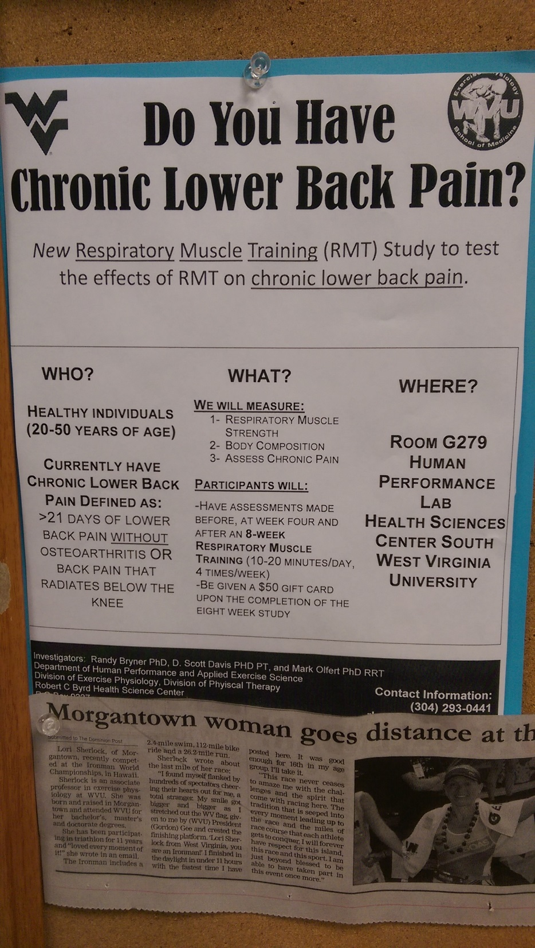
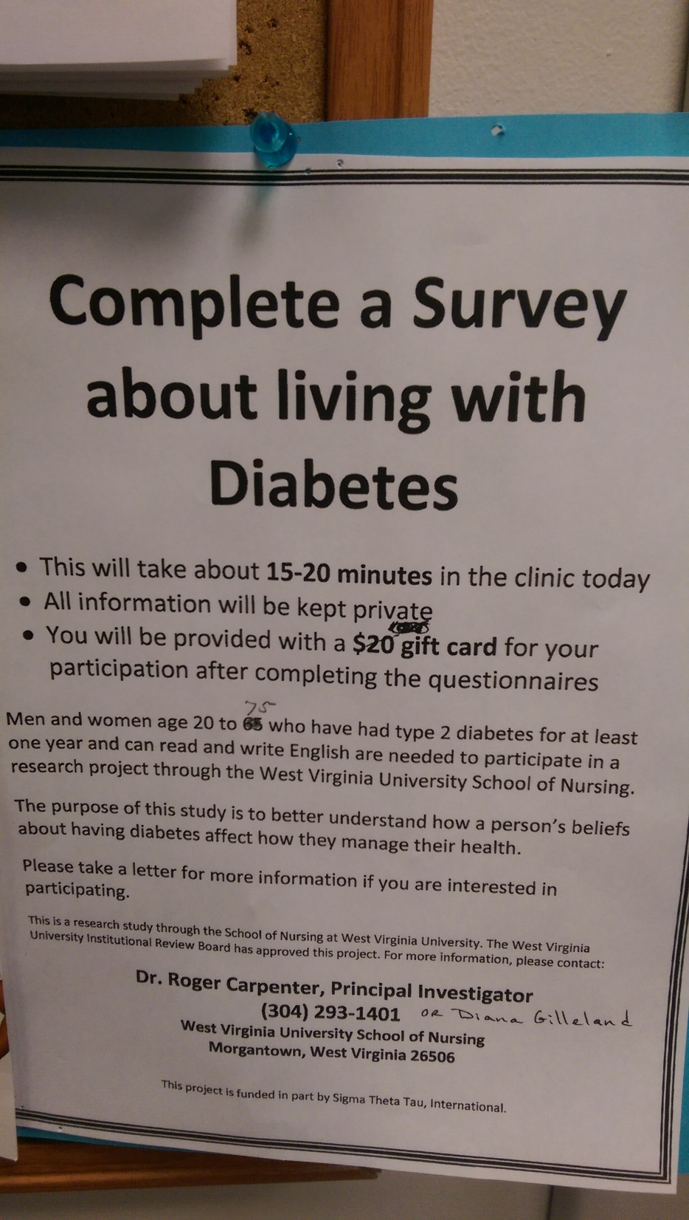

Slide 13
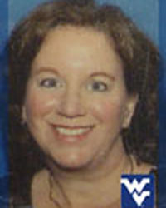
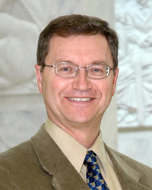
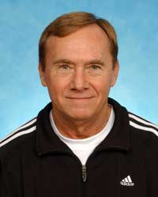
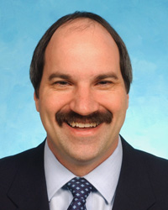
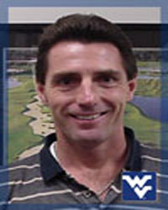
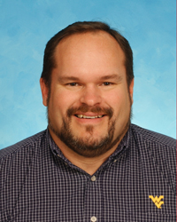
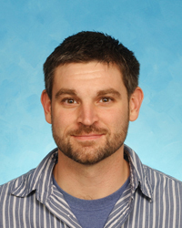
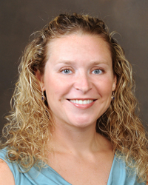
Faculty
Diana Gilleland
Stephen Alway
Guy Hornsby
Matthew Lively
Danny Bonner
Dave Donely
Jim Thomas
Lori Sherlock

