Slide 2
APRIL 15 – JULY 23 (2019)

Slide 4
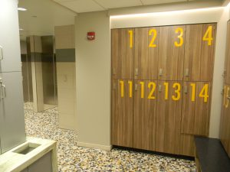
WELLNESS CENTER

Slide 5
WELLNESS CENTER WEIGHT ROOM

Slide 6
WELLNESS STUDIO (G-278 HSC SOUTH)

Slide 7
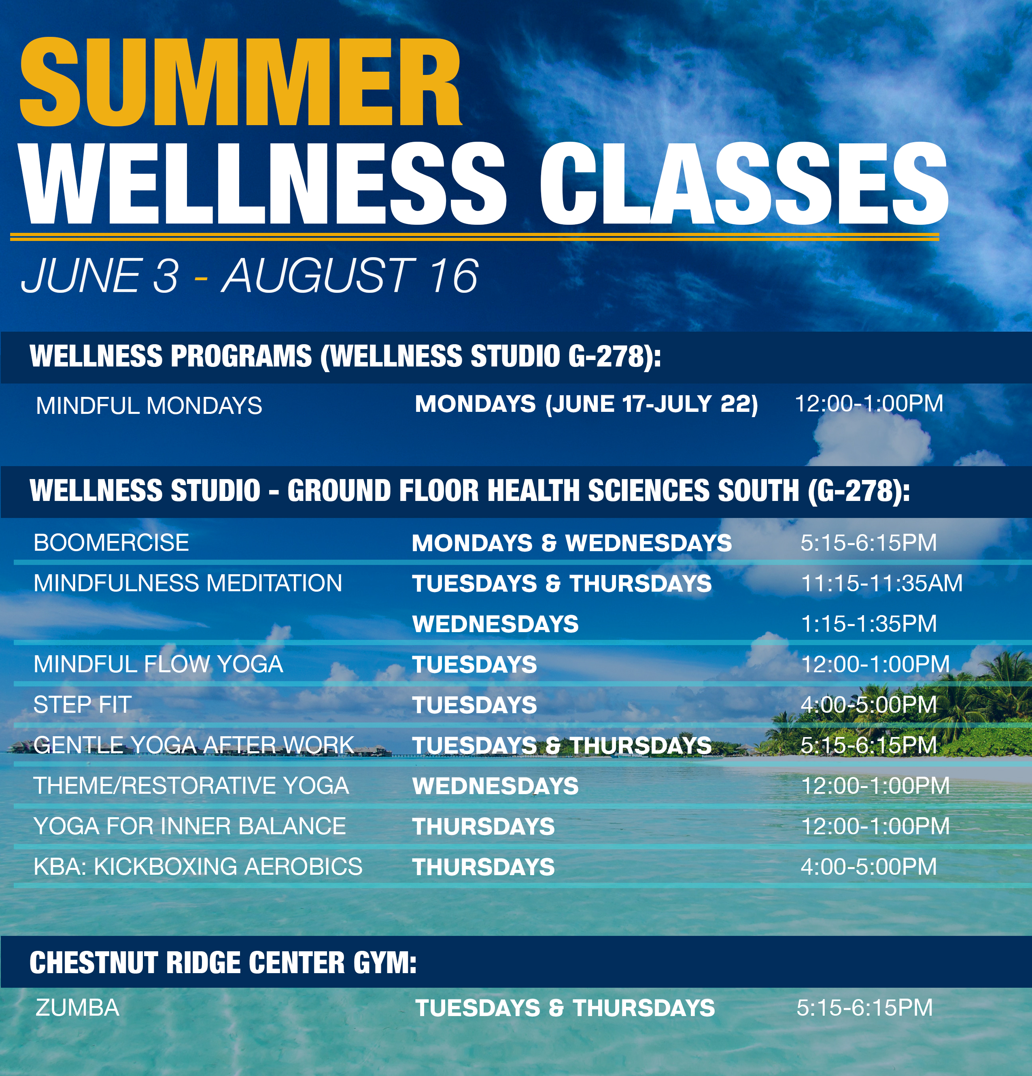
WVUMEDICINE.ORG/WELLNESS

Slide 8
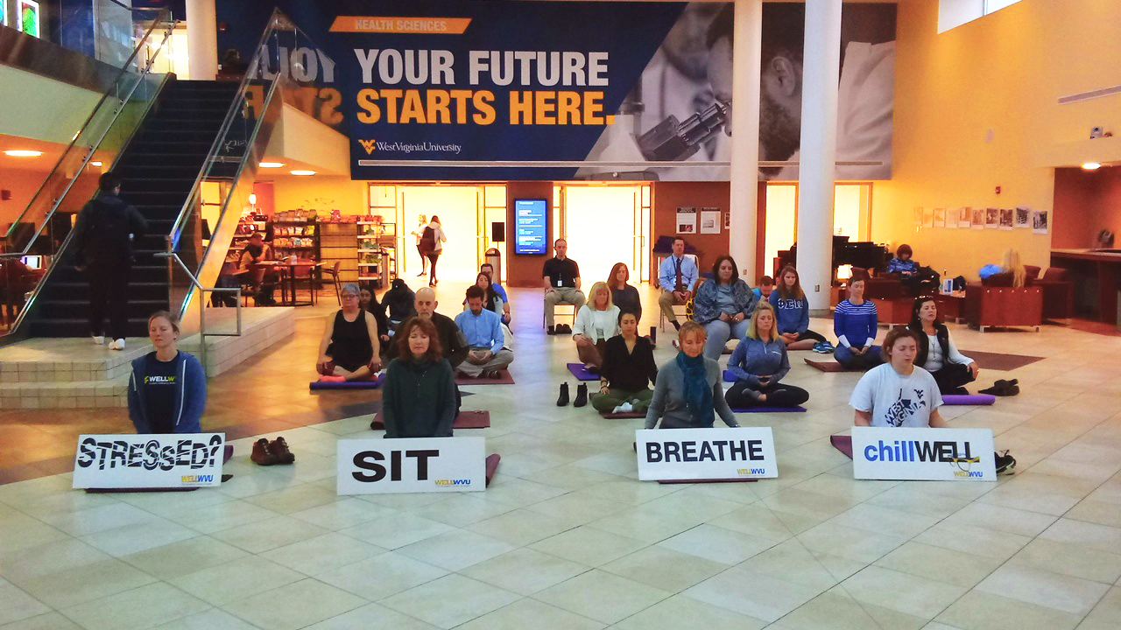
Mindfulness & Resiliency
Avoiding Burnout

Slide 9
Overall “Real Problem” We Are Attempting to Solve
Our focus as an institution has long been on the care of people when they become ill. Although that is a vital part of our mission, it is inadequate to the challenges we face in our state.
We must also focus on achieving and maintaining wellness – and start by changing our own campus community into a healthier place.
Change the culture from sick care to well care we will use both grass roots and leadership-driven approaches.

Slide 10
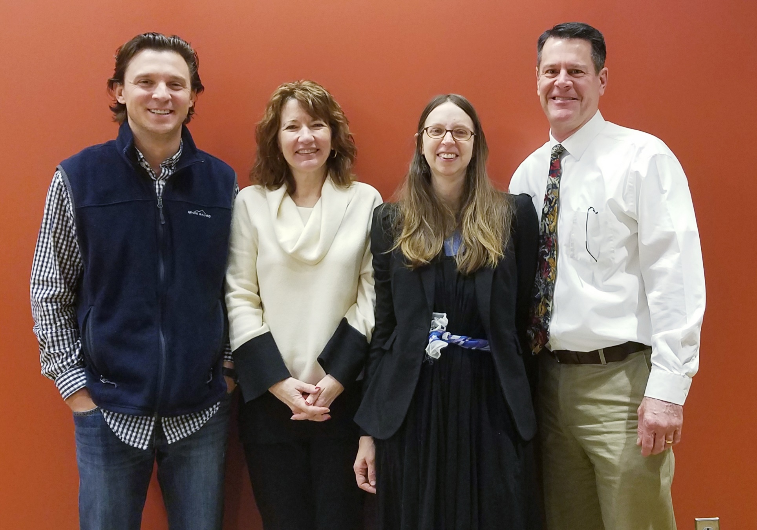
The Mindfulness Squad
Anthony Danko, Laurel Faulkenberry, Julie Brefczynski-Lewis, Dave Harshbarger

Slide 11
Data/Progress
“How often do you feel stress in your current position?” 30.8% responded “A lot. I feel it almost all of the time.”
This number shows that a significant amount of the campus population is not managing their stress levels.

Slide 12
Data & Progress
Another finding is that many faculty, staff and students feel a need for more of a personal connection to the work they do on campus. About 42% of respondents said that on 1-3 days per week, they brought meaning and larger purpose into their work or school life. One in five said this connection rarely if ever happened in their workweek.

Slide 13
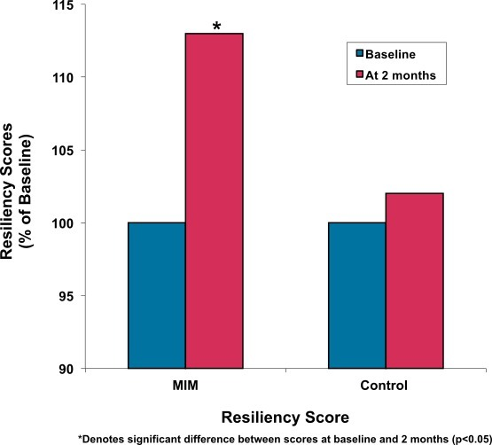
Mindfulness and Nurses Study Klatt, M., Steinberg, B. and Duchemin, A.M., 2015. Mindfulness in Motion (MIM): an onsite mindfulness based intervention (MBI) for chronically high stress work environments to increase resiliency and work engagement. Journal of visualized experiments: JoVE, (101).

Slide 14
Mindfulness Compassion training in Medical Students
Mascaro, Jennifer S., et al. "Meditation buffers medical student compassion from the deleterious effects of depression." The Journal of Positive Psychology 13.2 (2018): 133-142.

Slide 15
Resources Developed
Mindfulness Levels of Engagement:
Daily Meditation (20 minutes): daily sessions help strengthen mental muscle while promoting stronger mind-body connection, awareness and relaxation.
Sampler Workshop (60 minutes): a sample of simple and effective techniques aimed to change stress response, cultivating a more calm and resilient mind.

Slide 16
Resources (Continued)
Mindful Steps Series (6 hours): a free six-week series designed to assist in developing and maintaining mindful resilience, mental fitness & relaxation.
Yoga: Restorative, Mindful Flow, Gentle Yoga After Work, Yoga for Inner Balance, Themed Yoga

Slide 17
NEXT EXCITING STEPS
Nurse Residency Program - Collaborating with Wellness and Mindfulness to bring “wellness to the staff.”
The wellness/mindfulness group has observed nursing workflow on the units at Ruby.
By working together, the nurse residents will be able to take “moments” of wellness into the nursing units and incorporate short activities such as mindfulness breathing, yoga poses, etc. as part of the workflow for the nurses. Our research hopes to show that nurses are able to use just brief moments throughout the day to increase wellbeing.

Slide 18
Questions/Contact Info
Dave Harshbarger - harshbargerd@wvumedicine.org
Anthony Danko – anthony.danko@hsc.wvu.edu

