Slide 1
Clinical learning environment review (CLER)
Manuel Vallejo, MD, DMD
Designated Institutional Official for GME
Assistant Dean and Professor
West Virginia University

Slide 2
Elements of the CLER Visit
Professionalism
Supervision
Transitions of Care
Fatigue & Duty Hours
Health Care Disparities
Quality Improvement
Patient Safety

Slide 3
Health care disparity
Health disparities are preventable differences in the burden of disease, injury, violence, or opportunities to achieve optimal health that are experienced by socially disadvantaged populations
Populations can be defined by factors such as race or ethnicity, gender, education or income, disability, geographic location (e.g., rural or urban), or sexual orientation
Health disparities are inequitable and are directly related to the historical and current unequal distribution of social, political, economic, and environmental resources

Slide 4
A few definitions…
HEALTH DISPARITY - higher burden of illness, injury, disability, or mortality experienced by one population group relative to another
HEALTH CARE DISPARITY - differences between people groups in health insurance coverage, both access to and use of, and in quality of care
Health inequality and health inequity => you will hear these used interchangeably to describe differences that are socially determined and/or deemed to be unnecessary, avoidable, or unjust

Slide 5
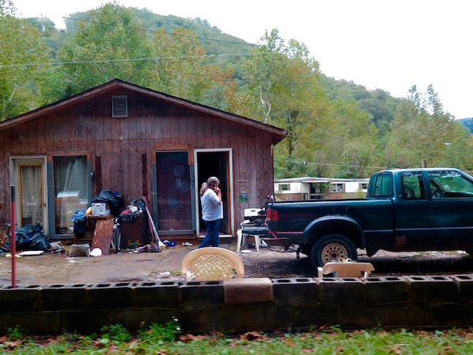
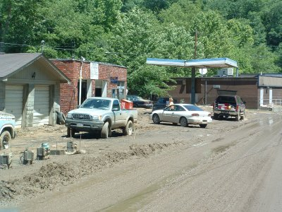
Health disparities result from multiple factors including
Poverty
Environmental threats
Inadequate access to health care/insurance
Individual and behavioral factors (i.e. smoking
Educational inequalities
Geographical/rural

Slide 6
Definition of Health Literacy
“The ability to obtain, process and understand basic health information, and services needed to make appropriate health decisions and to follow instructions for treatment.”
This is an issue with our patient population

Slide 7
Everyone has Biases
Explicit Bias has decreased significantly over the past 50 years
Implicit Bias is common and present in all of us

Slide 8
Implicit Bias and explicit bias
Implicit Bias - any unconsciously-held set of associations about a social group
can result in the attribution of particular qualities to all individuals from that group, also known as stereotyping
the product of learned associations and social conditioning
exerts more influence when stressed and fatigued
Explicit Bias - refers to the attitudes and beliefs we have about a person or group on a conscious level
their expression arise as the direct result of a perceived threat

Slide 9
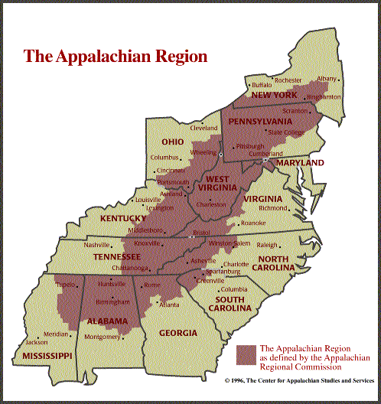
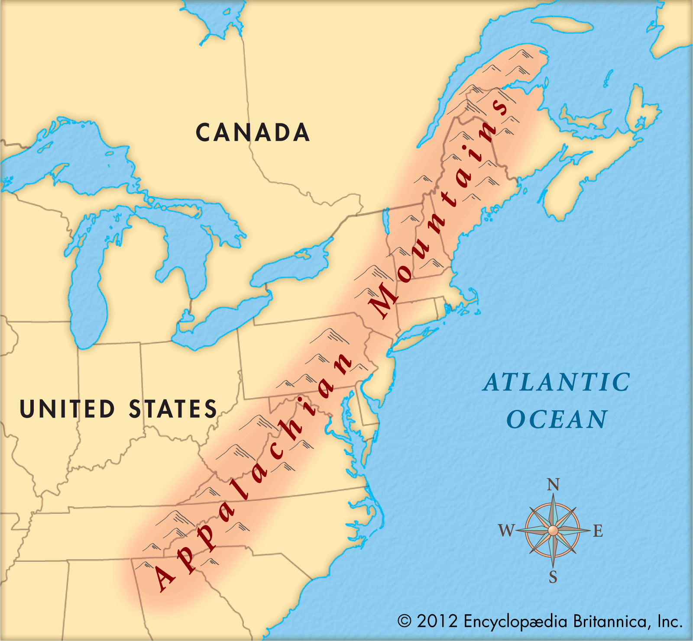
Notes:
The term “Appalachian” refers to the people who live along the spine of the Appalachian Mountain Range, stretching from southern New York State to northern Mississippi.
This includes selected counties in 12 states and all counties in West Virginia.

Slide 10
Characteristics of Rural WV
Environmental, transportation, financial and attitudinal barriers:
Isolation
Trust
Poverty
Education
Fatalism – belief that all events are predetermined and therefore inevitable
Religion
Confidence
Notes:
Deskins, Shelli PhD¹; Harris, Carole V. PhD¹; Bradlyn, Andrew S. PhD¹; Cottrell, Lesley PhD²; Coffman, Jessica W. MA¹; Olexa, Julie MPH¹; Neal, William MD² Preventive Care in Appalachia: Use of the Theory of Planned Behavior to Identify Barriers to Participation in Cholesterol Screenings Among West Virginians. Journal of Rural Health. 2006;22(4):367-374.

Slide 11
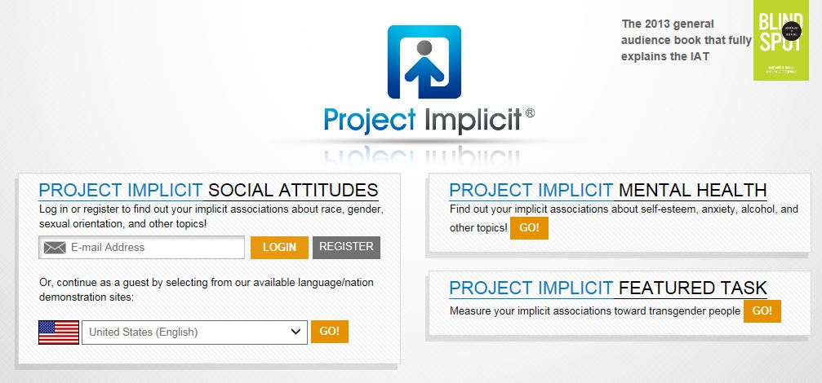
Tackling Implicit Bias
Increase Self-Awareness; Take IAT
https://implicit.harvard.edu/implicit
Individuating
Perspective-Taking; Increase Empathy
Participate in wellness events

Slide 12
Health Care Disparity Summary
Exists in WV and USA
Associated with the patient, physician and system factors
Each individual health care provider is a part of the solution to decrease HCD
Practice with each patient encounter => practice self awareness of HCD

Slide 13
Quality improvement (QI) gme expectations
Education on QI
Engagement in QI activities
Receive data on quality metrics to improve
Engagement in planning for quality improvement
Notes:
The ACGME expects us to provide residents and fellows with the following:

Slide 14
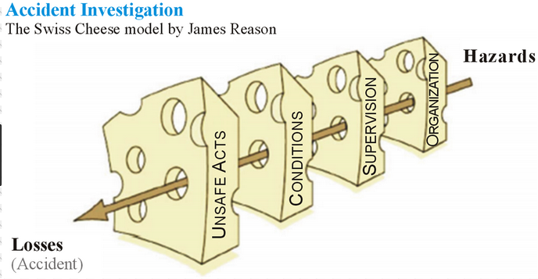
SWISS CHEESE MODEL – James Reason Also used for Root Cause Analysis Investigations

Slide 15
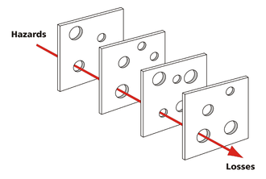
Swiss cheese model steps
The slices represent your organization’s barrier systems – double checks, comprehensive H & Ps, etc.
The holes represent the holes in your organization’s barrier systems – medications with similar labels, EHRs with difficult to find tools for pediatric medication calculations, etc.
As the group proceeds with labeling the model, problem “holes” will become apparent and may then be isolated for improvement

Slide 16
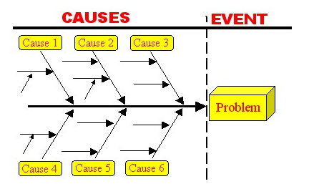
FISHBONE DIAGRAM Used when conducting Root Cause Analysis (RCA) investigations
During the Fishbone Diagram Analysis, causes are grouped into two categories:
External – (i.e. economy, weather, legislation) List them but do not spend much time – these causes are difficult or impossible to influence.
Internal – (i.e. scheduling, room allocation) these are causes you can influence

Slide 17
Fishbone diagram steps
Clearly define the problem
Brainstorm with your team to identify causes, both external & internal that contributed to the problem
Practice the 5 Whys – speak with those involved –
Ask why - listen to answer
Ask why - listen to answer, etc.
Each time you ask why, you come closer and closer to the root cause of the problem

Slide 18
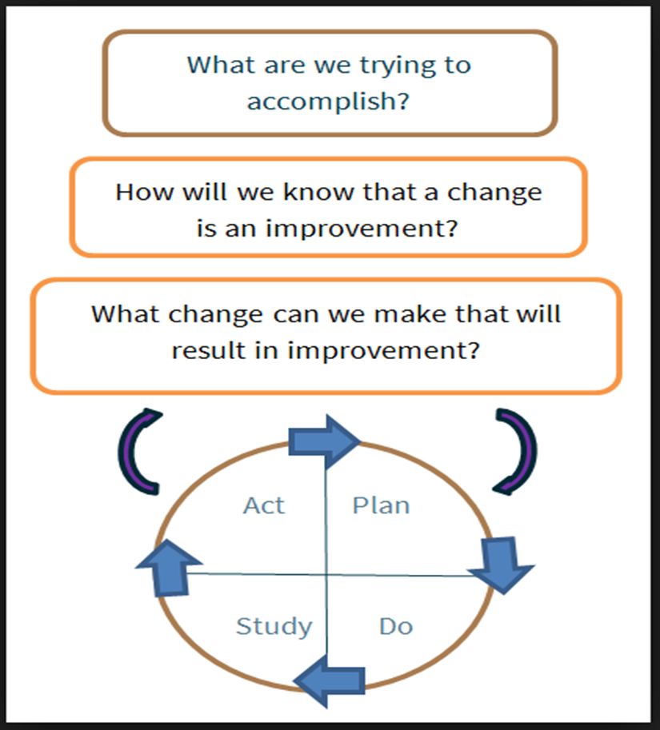
Education – Initiating a quality improvement project
Ask yourself these questions…
How are we doing?
How do we know?
How can we do better?
How can we make it safer?

Slide 19
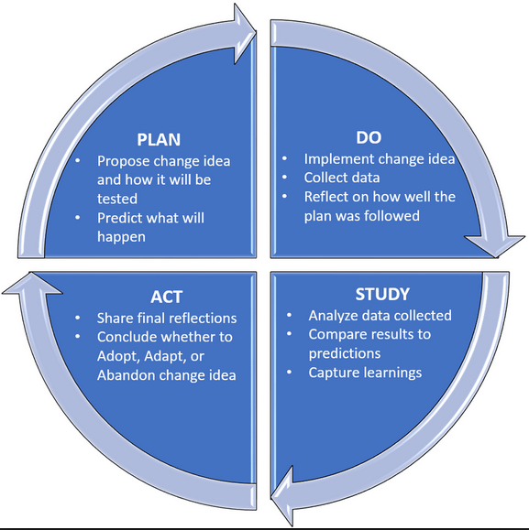
Pdsa cycles

Slide 20
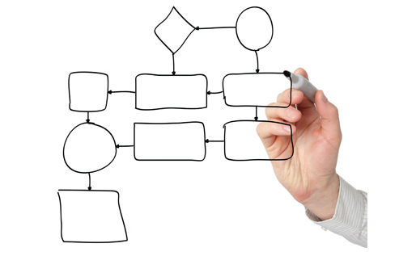
Process Mapping
To improve a process, you must first
define the steps involved in that process
Notes:
Once you have decided what process to change, drawing a process map will allow you to break the process down into its individual parts. This provides a way to assess each part to see where an improvement could be tested.

Slide 21
Levels of measurements
Outcome measures – where are we ultimately trying to go?
Process measures – are we doing the right things to get there?
Balancing measures – are the changes we are making to one part of the system causing problems in other parts of the system?

Slide 22
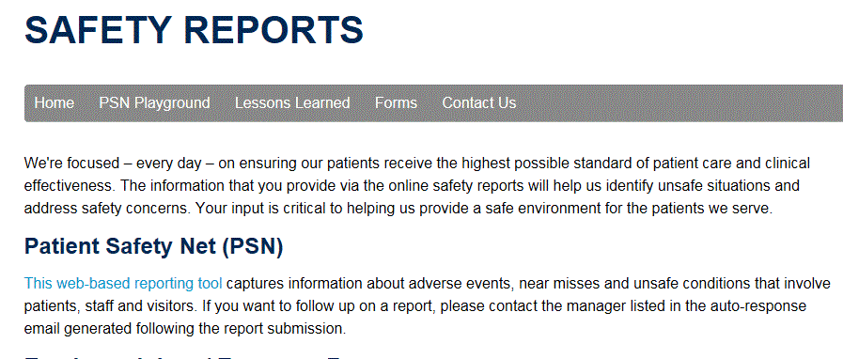
Patient safety

Slide 23
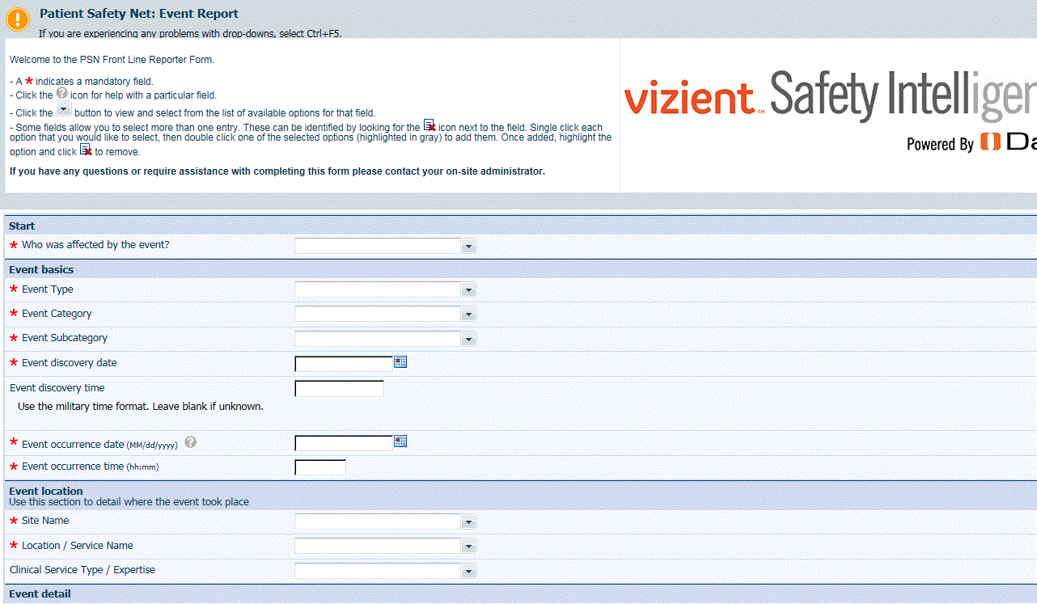

Slide 24
GME Supervision
Supervising faculty, fellows and senior-level residents, will provide appropriate levels of clinical supervision in a supportive, and non-retaliatory manner
Your department will provide you with specialty specific guidelines for requesting supervision
Your first 6 months will be carefully supervised. Following that, you will receive progressive independence based off past performance

Slide 25
Levels of Supervision
Direct Supervision – the supervising physician is physically present with the resident and patient
Indirect Supervision
with Direct Supervision immediately available – the supervising physician is physically within the hospital or other site of patient care, and is immediately available to provide Direct Supervision
with Direct Supervision available – the supervising physician is not physically present within the hospital or other site of patient care, but is immediately available by means of telephonic and/or electronic modalities, and is available to provide Direct Supervision
Oversight – the supervising physician is available to provide review of procedures/encounters with feedback provided after care is delivered

Slide 26
WVU GME Supervision Policy
Resident supervision standards:
Notify attending if patient is being discharged, transferred to the ICU, dies, leaves AMA, etc. – any major or unexpected change in status
Calling for supervision is NOT a sign of weakness – it shows that you place the safety of your patient above all else
Mistreatment from an attending is NOT acceptable. Speak with your PD, or submit a Mistreatment report via The Button, and GME will get involved

Slide 27
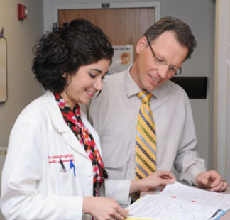
WVU GME Supervision Policy
Supervision
By teaching staff and senior/chief residents
Faculty call schedules are organized to make support readily available
Your quality of supervision is monitored by annual surveys (WVU GME, ACGME resident survey and ACGME faculty survey)
If surveys are concerning, PD, with the help of the PEC, will create an action plan which will be submitted to the GMEC

Slide 28
GME Resident Supervision Survey
Assigned semi-annually, in early November, and May, via E-Value
Helps us track where problems exist, or are developing
Short & concise – please complete as soon as you receive the notification
Data is important to help GME keep tabs on Supervision issues throughout the learning environment

Slide 29
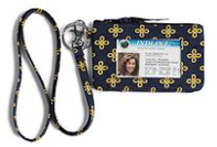
Clinical Strategies to Help Patients Understand the Supervision Hierarchy
Update dry erase boards in each patient’s room with names of physician staff caring for that patient
Always wear ID Card
Always tell the patient who you are, and what role you play in their care

Slide 30
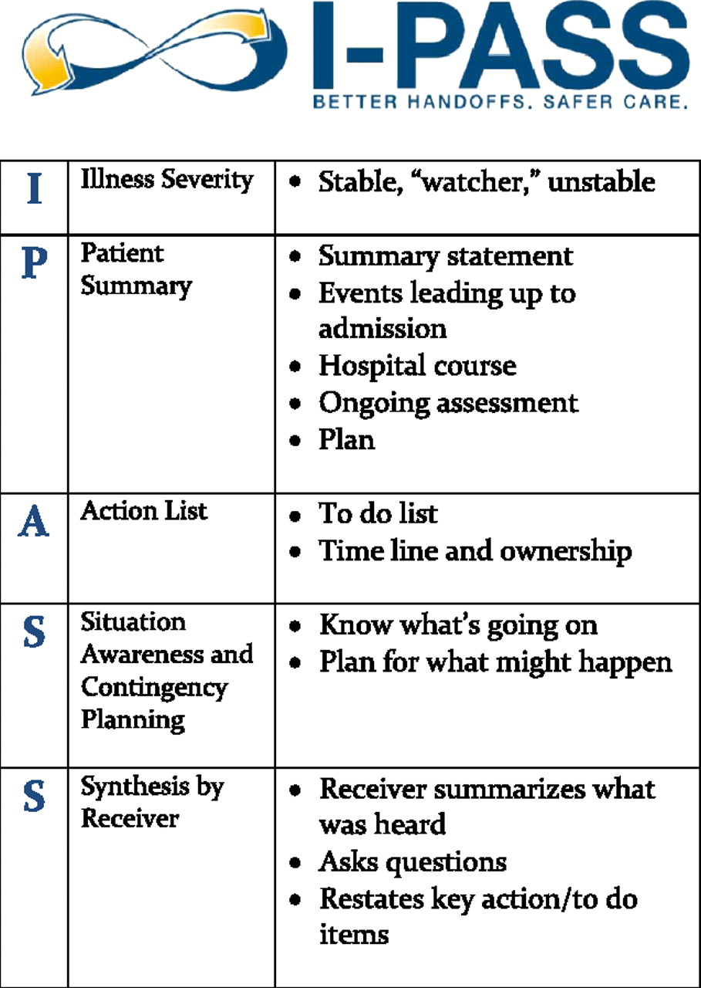
Transitions of care
A time when patient care information is routinely lost => patient harm
Department specific
Many are part of the electronic medical record
Specific types
I-Pass
Daily Huddles
Timeout in the Operating Room
SBAR

Slide 31
Questions?

