Slide 1
Embracing the Profession of Medicine
Be Worthy of Your Patient’s Trust
Manuel Vallejo, MD, DMD
Designated Institutional Official for GME
Assistant Dean & Professor
West Virginia University

Slide 2
“Profession” Is The Root of Professionalism
Profession: an occupation that involves prolonged training and formal qualification
Regulates itself & upholds ethical standards
Recognized by society as possessing special knowledge and skills
Our profession is the diagnosis, treatment, and prevention of disease
Notes:
Acquisition and application

Slide 3
ACGME Definition of Professionalism
According to the ACGME, residents must:
“Demonstrate a commitment to carrying out professional responsibilities and an adherence to ethical principles”
You will accomplish this with:
Compassion, integrity, & respect for others
Attention to patient needs superseding self-interest
Respect for patient privacy & autonomy
Accountability to patients, society & the profession
Sensitivity to diverse patient population

Slide 4
Why Is This Important?
Public concerns that physicians are impersonal, dishonest and self-serving
Corporate transformation of medicine
Professionalism should form the basis of the social contract between medicine and society
Patients are more likely to adhere to treatment guidelines if they trust physicians
Notes:
Quote from Sir William Osler: “You are in this profession as a calling, not as a business, as a calling which extracts from you at every turn self-sacrifice, devotion, love and tenderness toward your fellow men. Once you get down to a purely business level, your influence I s gone and the true light of your life is dimmed. You must work in the missionary spirit, with a breadth of charity that raises you far above the petty jealousies of life

Slide 5
Medical Professionalism in 2019
Physicians are closely scrutinized by society
Patients can research a physician’s record
Any disciplinary action is often public record
Notes:
Patients can use Internet databases, state medical board sites,

Slide 6
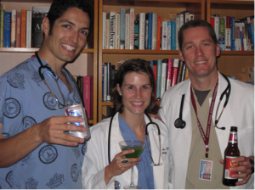
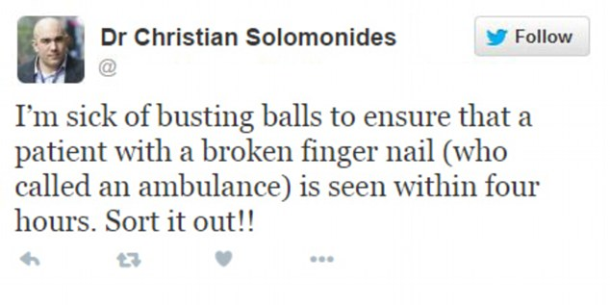
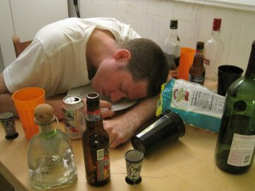
Social Media: You represent your profession at all times
Facebook, Twitter, Instagram
What’s appropriate?
What do students, residents, faculty post?
use of foul language, controversial subjects
negative comments about patients, colleagues, & al.
you will be amazed at the stuff you’ll see
you can destroy your reputation

Slide 7
Core Tenets of Professionalism
Adherence to standards
accept responsibility for continuity of care
Empathy & Sensitivity to
situation, culture, diversity
Accountability
accept responsibility for your behavior and how it impacts patient care
Commitment
improvement of personal character
integrity, altruism, empathy
Notes:
Continuity of care specifically difficult for residents who do shift work – now common even outside of my specialty with new duty hours

Slide 8
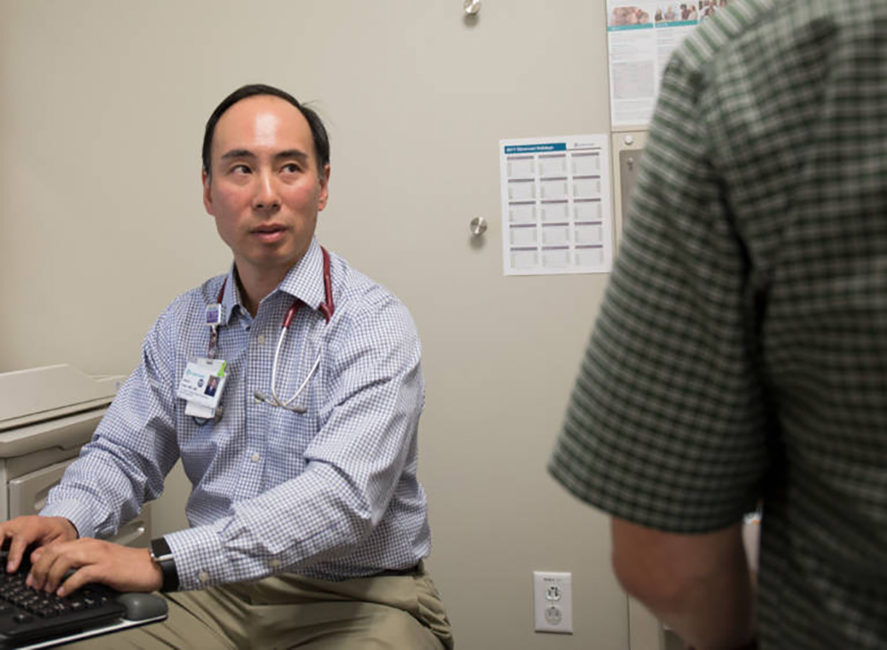
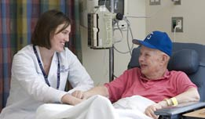
Patient Interactions
Introduce yourself and your role
Greet your patient
Show interest in patient’s thoughts
Respectful communication
Involve patient in decisions
Show care & concern
Give appropriate expectations
Notes:
Appropriate expectations inlcudes discussion of the next steps

Slide 9
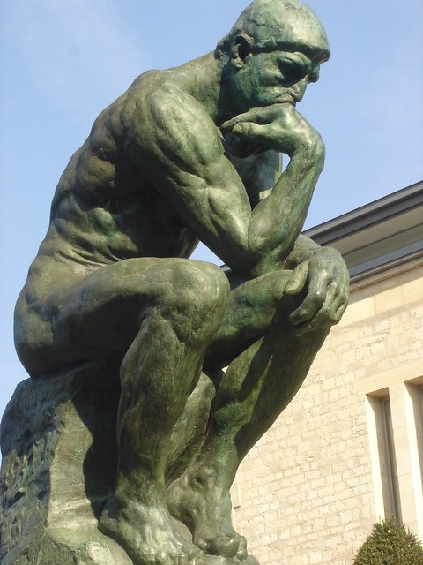
Steps of Clinical Judgment
The Diagnostic question – what IS wrong with the patient? (Hx, physical exam, PMH, lab results)
The Therapeutic question – what CAN be done for the pt? (informed by scientific evidence)
The Prudential question – what SHOULD be done for the pt – involves individual and diverse considerations

Slide 10
Ten Bits of Advice That I Hope Will Help Make You a Better Physician and Professional

Slide 11
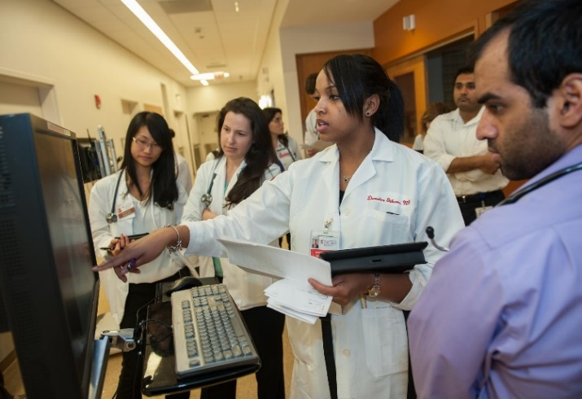
1. Be a Good Role Model
Students identify residents & fellows as key role models, not faculty
Be positive
Hold yourself accountable
Take time to teach
Treat others the way you want to be treated

Slide 12
2. It’s ALL your job

Slide 13
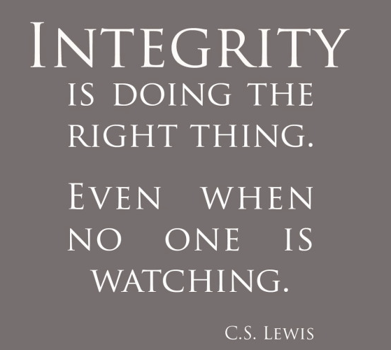
3. Integrity Counts
Be Honest
Be Accountable…people remember
Have the courage to speak up – the patient must always comes first

Slide 14
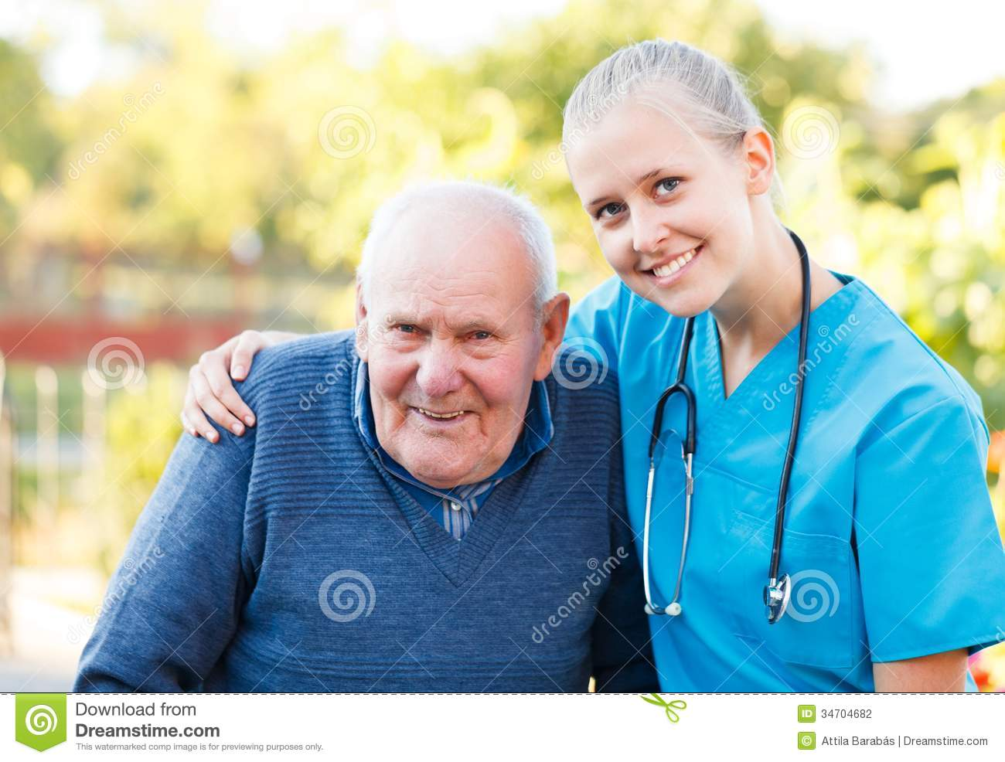
4. Be Humble
Your first name is not “Doctor”
The team comes before any individual member

Slide 15
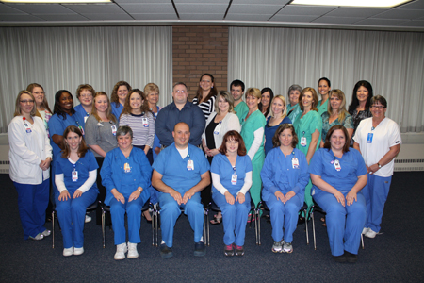
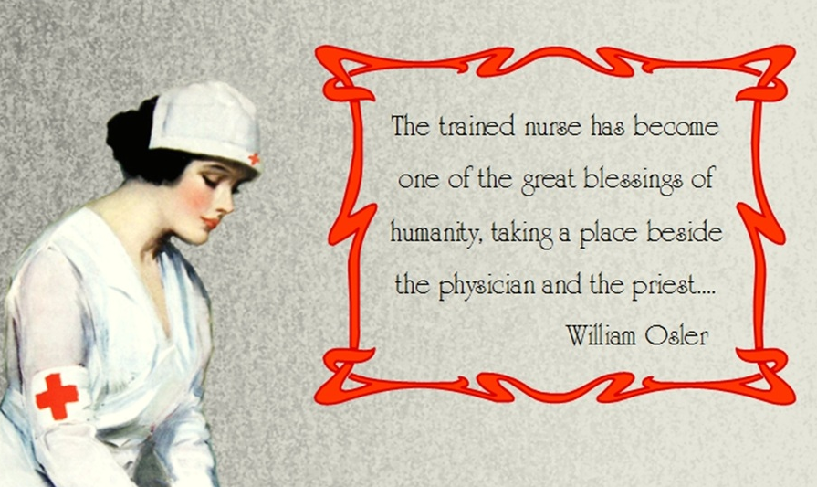
5. Treat Nurses (& All Staff) with RESPECT!
They are your colleagues in all aspects of patient care
Not your minions
If you wish to be treated with respect...
They will teach you – learn from them

Slide 16
6. STUDY
No matter how great your bedside manner may be... your eye won’t see what your mind doesn’t know
Read
Go to your department & interdepartmental conferences
Look for learning opportunities
Milestones and standards must be met

Slide 17
7. Use Your Common Sense
Cultivate the habit of regarding every case from the patient’s point of view
Treat patients and not their diseases
Don’t neglect your own ailments

Slide 18
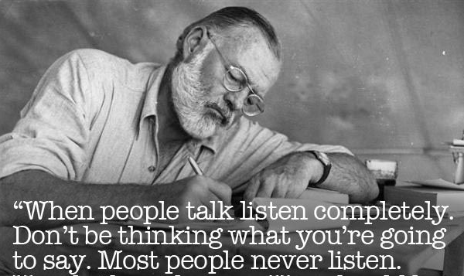
8. Listen When Others Talk
Patients
Family members
theirs, and yours
Consultants
Colleagues

Slide 19
9. Admit your mistakes and learn from them
For physicians, being involved in an error evokes
Shame
Humiliation
Fear
Panic
Self-doubt
Coping mechanisms include
Denial
Distancing
...ask for help if you need it or if you see that one of your colleagues does

Slide 20
10. Have High Expectations of Yourself
What do you expect of yourself ?
Remember why you entered the medical profession
You have the choice of being the kind of physician you wish to be
Reflect, make changes, evolve => Become Better

Slide 21
Final Thoughts
Use our Resources:
Chief Residents
Program Manager
Program Director
Dr. Vallejo (DIO)
Dr. Ferrari (Vice Dean and Chair of Medical Education)
Don’t hesitate to contact us if we can help you
Whatever the question, you aren’t the first to ask it

Slide 22
Thank You

