Slide 1

Antimicrobial Resistance & Stewardship
John Guilfoose ID
6/17/2019

Slide 2
Questions:
What is Stewardship?
  responsible planning and management of a valuable resource
  antibiotic are a resource that deserve judicious use / smart use
Why Antibiotics?
  Auto-obsolete
    self extinguishing efficacy
  Use in one patient can affect health of others !!!

Slide 3
“Sir” Alexander Flemming’s war time miracle
1945 Nobel Prize
One of the most important developments of modern medicine
  2 decades to average life expectancy - ☺ wow

Slide 4
Antibiotics – a selective pressure for evolution

Slide 5
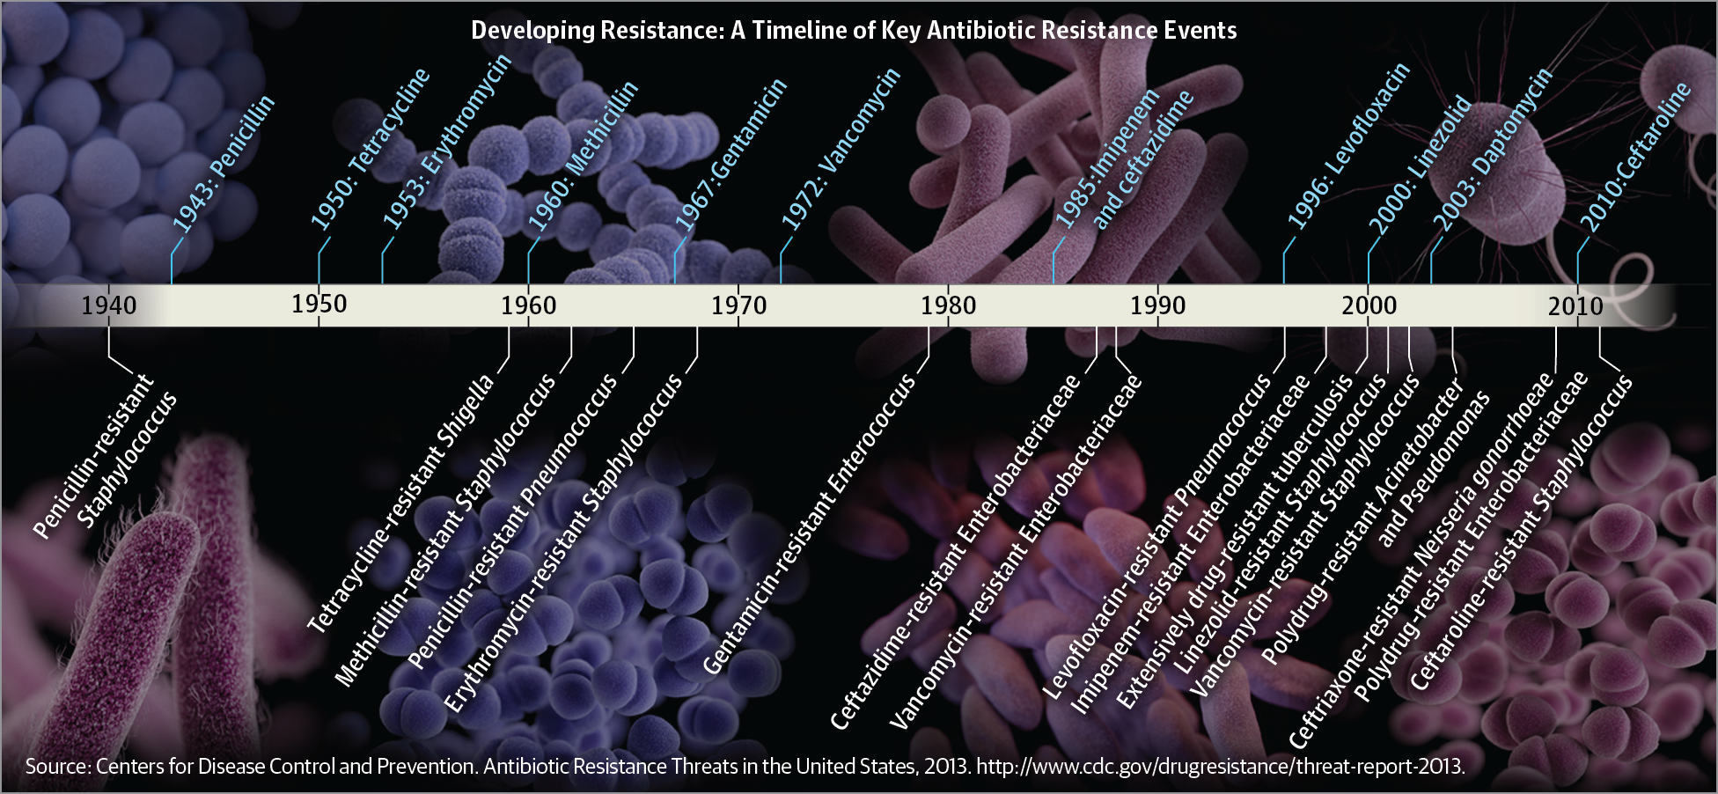

Slide 6
Fleming’s heavy stewardship statement
1945
  “... the microbes are educated to resist penicillin and a host of penicillin-fast organisms are bred out... In such cases, the thoughtless person playing with penicillin is morally responsible for the death of the man who finally succumbs to infection with the penicillin-resistant organism. I hope this evil can be averted.”
  “…don’t use penicillin unless there is a properly diagnosed reason for it to be used”
  “…never use too little, or for too short a period”

Slide 7
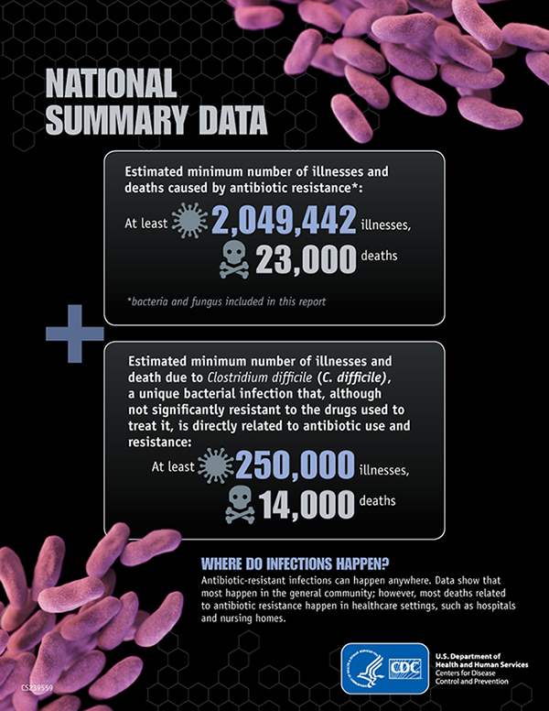
So how bad is it?
Direct healthcare costs estimated to be as high as $20 billion annually in USA
More people die of MRSA infections that HIV and TB combined in USA

Slide 8
“… the end of modern medicine as we know it …”
(Margaret Chan, Director General of the World Health Organization, 2012)

Slide 9
Antibiotic-Resistant Bacteria: Threats
The Centers for Diseases Control and Prevention (CDC) has identified 6 bacteria that are among the most deadly antibiotic-resistant bacteria:
  ESBL-producing Enterobacteriaceae (extended-spectrum ß-lactamases)
  CRE (carbapenem-resistant Enterobacteriaceae)
  Multi-drug resistant Pseudomonas aeruginosa
  Multi-drug resistant Acinetobacter
  MRSA (methicillin-resistant Staphylococcus aureus )
  VRE (vancomycin-resistant enterococci)

Slide 10
1/3 to 1/2 antibiotic prescriptions in hospitals have potential “prescribing problems”
  dose, spectrum, indication, duration

Slide 11
WVU Abx Usage data (DOT)

Slide 12
Antibiotic Use Data
Prescriptions per 1000 persons of all ages, 2010
Colo — 0.628
Wash — 0.611
Calif — 0.6
Ore — 0.595
Alaska — 0.529
WV — 1.237
Ky — 1.232
Ten — 1.199
Miss — 1.159
Alabm — 1.132
WV in top 5!!
Hicks LA, et al. N Engl J Med 2013;368:1461-2.

Slide 14

Antimicrobial Stewardship Committee
As of 2017 -- everyone needs one now !!!!
  The Joint Commission (aka, First Order) now require that all hospitals and nursing care centers have antimicrobial stewardship programs
    facilities that receive CMS funding and/or Joint Commission accreditation
  eventually comparing health care facilities of similar size and patient populations

Slide 15
WVU Medicine Antimicrobial Stewardship
Mission Statement:
To ensure improved patient care through the appropriate utilization of antimicrobials with focused efforts to minimize antimicrobial resistance
Implicit Goals
  Improved patient outcomes
    Safety / reduced adverse events related to antibiotic use (1 in 5)
      including Clostridium difficile infection
      minimize other side effects
  Improved bacterial susceptibilities to targeted antibiotics
  Optimization of resource utilization

Slide 16
Our Team – All of You !!!
John Guilfoose, MD, Co-Chair
Infectious Diseases
Lisa Keller, Pharm.D., Co-Chair
Pharmacy
Aaron Cumpston, Pharm.D.
Bone Marrow Transplant
Nasira Roidad, MD
Infectious Diseases- OPAT
Rachel Hudik, NP
APPs/Med Hospitalists
Christine Kincaid, MD
Outpatient/Pediatrics
P. Rocco LaSala, MD
Microbiology/Pathology
Allison Lastinger, MD
Infectious Diseases
Meera Mehta, Pharm.D.
Pharmacy-OPAT
Lisa Garavaglia, Pharm.D.
Pediatric Pharmacy
Kathy Nigh, RN
Infection Prevention
H. Carl Palmer, MD
Medicine
Nicole Kovacic, Pharm.D.
Medical ICU
Karen Petros, Pharm.D.
Surgical ICU
Douglas Slain, Pharm.D.
Infectious Diseases
Blake Hays, Pharm.D. Emergency Medicine

Slide 17
“Passive” prescriber-led Interventions
Education tools to assist with empiric regimen selection
  WVU antibiotic guidance site
    Picking empiric therapy is very very very very complicated
    Provide online decision support resources / tools for optimal empiric therapy
    Themes :
      Narrowest spectrum to be successful (least selective pressure)
      Safety
      Avoid C diff as much as possible (“C diffogenic drugs”)
      Microbiome sparing?
    CAP example – Amp/Doxy vs other national guideline based suggested regimens
  Smart Sets for antibiotic choice (reflect the above)
  Alternative Selection Alerts
  Reminders of MDR risks in ordering instructions

Slide 18


Slide 19
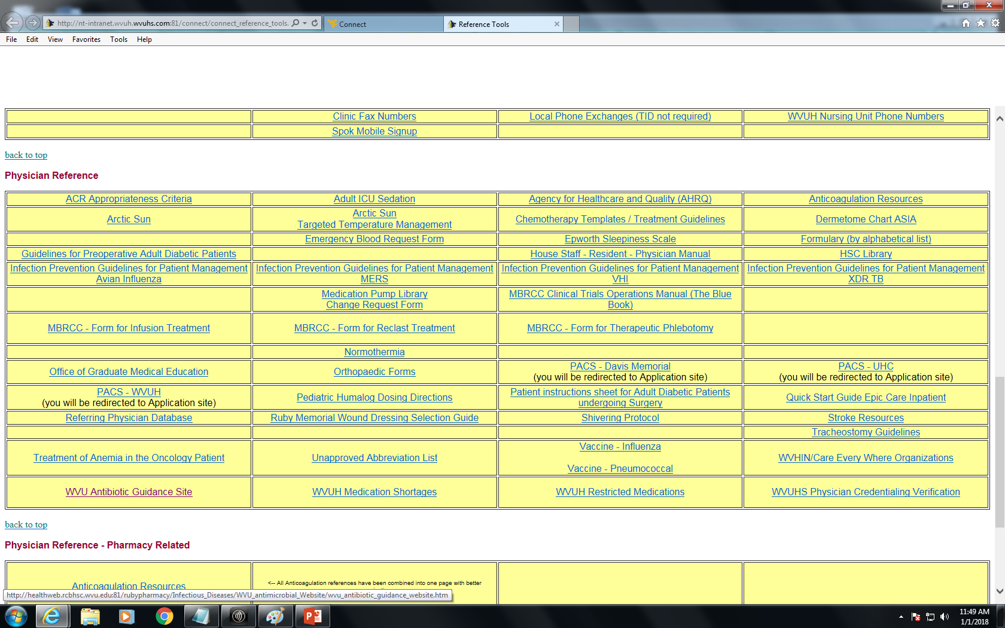

Slide 20
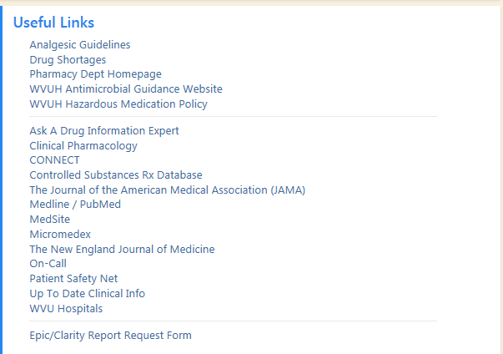
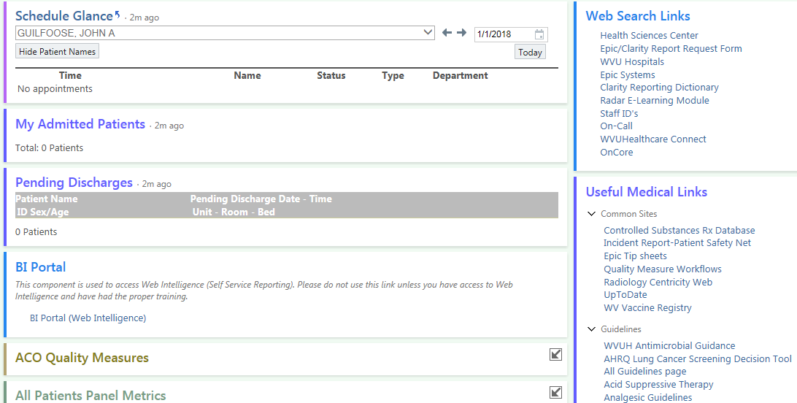
from your EPIC home page

Slide 21
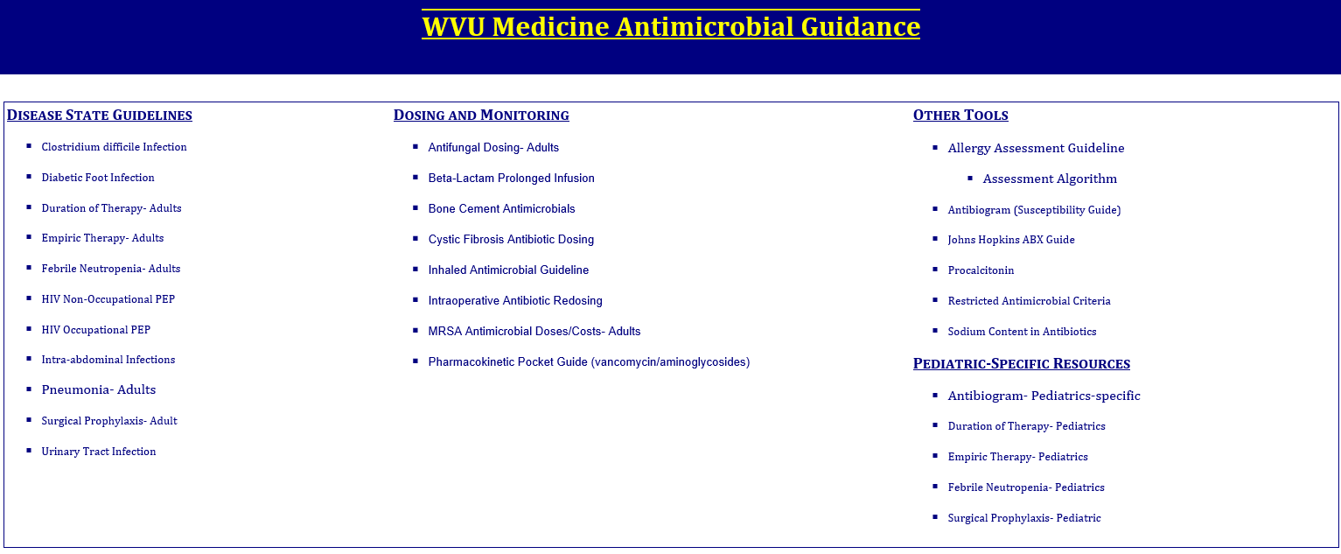

Slide 22
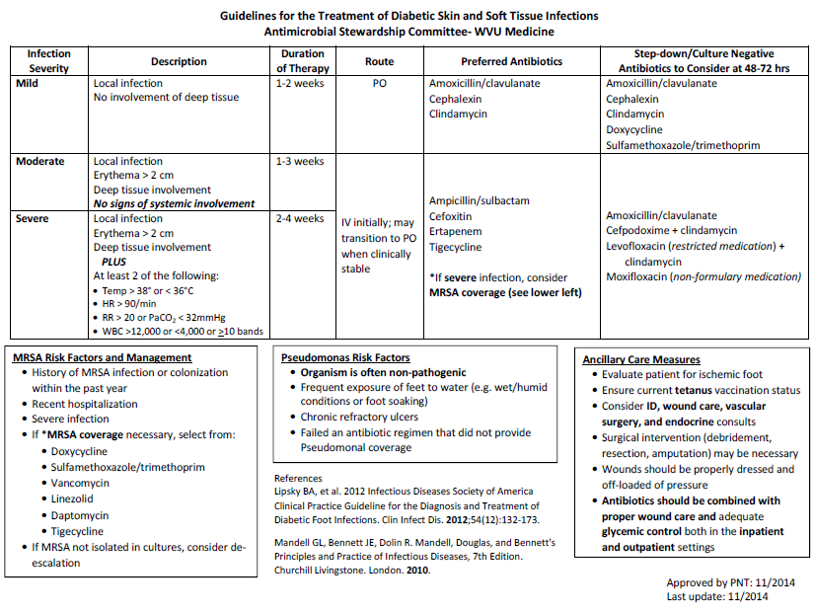

Slide 23
Passive prescriber-led Interventions
Smart Sets
  Example: Sepsis
  Optimized for source
  Introduce antibiotic heterogeneity
    previously done by random abx cycling
  Safety
    alternatives to Vanc/Zosyn ☺
    encourage stat dosing
Endocarditis: Vancomycin + cefepime
Meningitis: Vancomycin + cefepime + doxycycline; Add ampicillin if listeria risks
Skin and Soft Tissue: Linezolid + piperacillin/tazobactam OR Vancomycin + cefepime + metronidazole
Urinary Tract: Vancomycin + cefepime OR Linezolid + piperacillin/tazobactam
Intra-abdominal: Linezolid + piperacillin/tazobactam OR Vancomycin + cefepime + metronidazole OR Severe (anaphylaxis) beta-lactam allergy: linezolid + aztreonam + metronidazole
Pneumonia: Linezolid + piperacillin/tazobactam + doxycycline OR Vancomycin + cefepime + doxycycline
Immunocompromised: Vancomycin + cefepime OR Severe (anaphylaxis) beta-lactam allergy: aztreonam + tobramycin in place of cefepime
Unknown: Vancomycin + cefepime OR Vancomycin + piperacillin/tazobactam

Slide 24
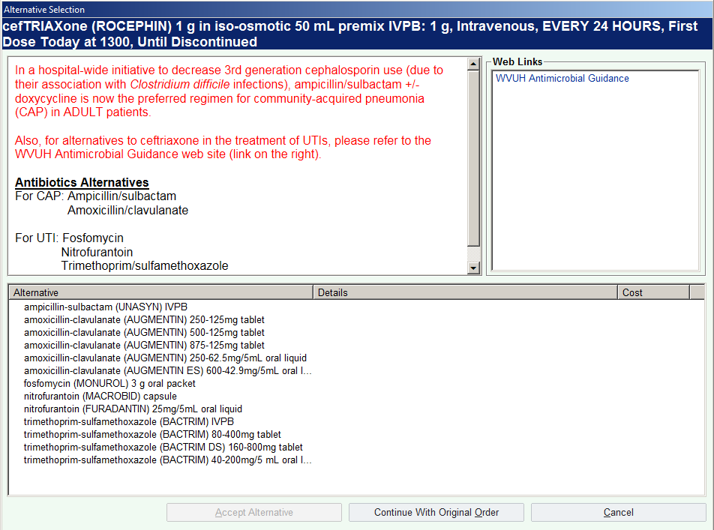
Passive prescriber-led interventions
Alternative selection alerts
  An alternate way to reference the WVU guidance page
  Also, keeps providers aware of drug shortages, cost, safety issues, PO equivalent formulations available, etc.

Slide 25
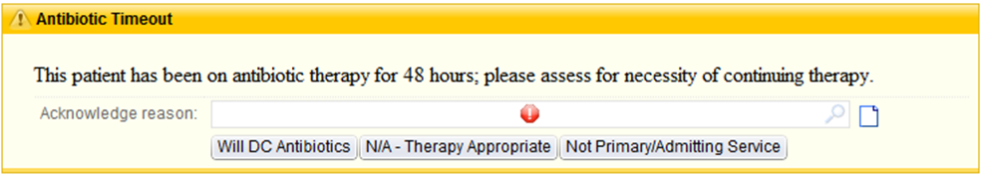
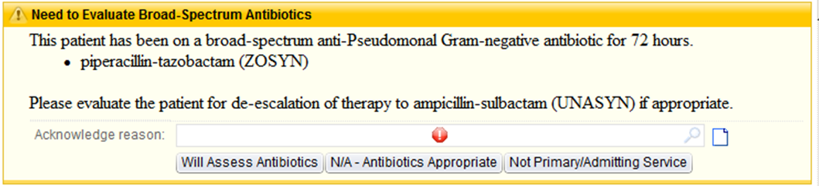
  Passive Interventions: De-escalation Reminder
    48-hour “Antibiotic Timeout”
    72-hour alert reminder for de-escalation

Slide 26
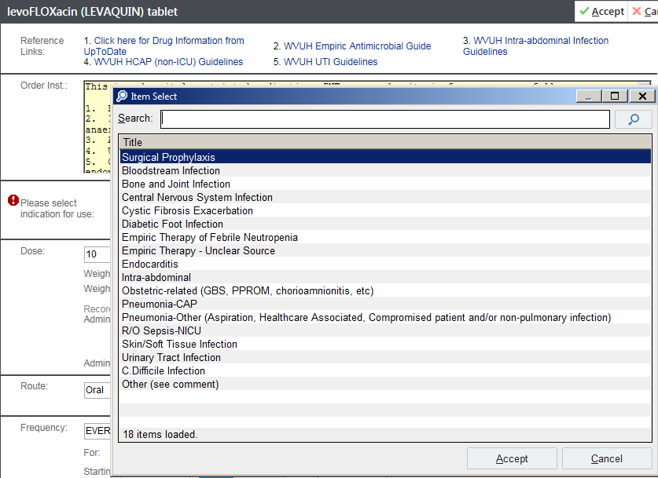
Passive prescriber-led interventions
Documentation of antibiotic indication
Anticipated duration of therapy entry (non-binding)

Slide 27
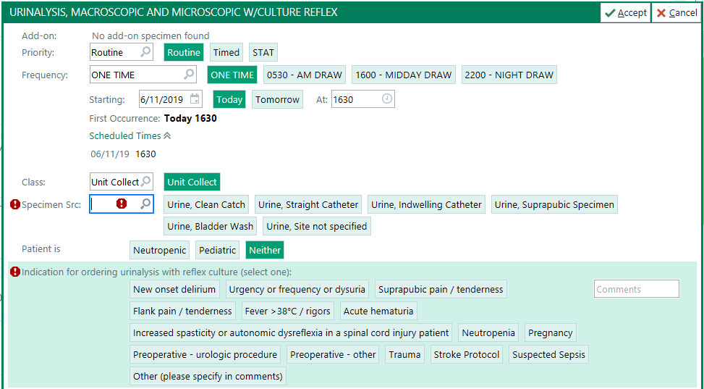
Passive prescriber-led interventions
Documentation of urine culture indication for ordering
Growth of bacteria on Urine culture alone does not establish that a patient has a UTI. The patient's symptoms & clinical context are of central importance in determining UTI vs asymptomatic bacteriuria.

Slide 28
Passive prescriber-led interventions
Reminders of MDR risks in ordering instructions for certain Antibiotics
Example: anti-Pseudomonas agents
  Skin/soft tissue
  Burns
  Water exposure to wounds/trauma/puncture wound
  External otitis/perichondritis
  Pulmonary
    Cystic fibrosis
    Chronic lung disease (bronchiectasis)
    HAP/VAP
  Injection drug users
  Prolonged hospitalization/exposure to antibiotics
  Neutropenia
  Critical illness/sepsis

Slide 29
Active Interventions by the Committee
Formulary decisions
Pre-prescription authorization (PPA)
  “Restriction”
Post-prescription review with feedback (PPRF)
  phone call from committee after a few days

Slide 30
  Active intervention: Pre-prescription authorization (PPA)
    Restricted antimicrobials: only 9
      Resistance prevention / induction (Pharmacist reviews – criteria on WVU Abx Guidance Web Page)
        Ciprofloxacin
        Levofloxacin
        Meropenem
      Cost (ID Consult/Curbside)
        Fidaxomicin
        Dalbavancin
      Newer meds w/ uncertain ideal use situations (ID Consult/Curbside)
        Ceftazidime/avibactam (Avycaz) … ESBL
        Ceftolozane/tazobactam (Zerbaxa) … Pseudomonas
        Meropenem/vaborbactam (Vabomere) … KPC
        Eravacycline (“Tige 2.0”)

Slide 31
Pre-prescription authorization (PPA)
The Johns Hopkins Hospital Restricted Abx

Slide 32
  PLEASE HELP - Allergy clarification / verification
  PCN allergy
    Bad news: places patients at risk of prolonged length of stay, readmissions, and acquisition of multidrug-resistant organisms, treatment failure, resistance generation, and increased mortality
    Good news: most patients who have a history of penicillin allergy are not really allergic to penicillin
      10% of all patients in the United States carry a label of penicillin allergy
      True penicillin allergy is around 1-2%
      IgE antibodies can disappear with time
        most patients becoming skin-test negative after a decade
    Clarify reaction
    Call Outpatient Pharmacies
    Look through EPIC to see if ever received an alternative B-Lactam
    Consider using inpatient Allergy consult (Dr. Peppers)

Slide 33
Active Interventions - Allergy clarification / verification
Cephalosporins
  less than 5% patients demonstrated cross-reactivity
  third-and later-generation cephalosporins less than 2%
Carbepenems
  less than 1 % of penicillin-allergic patients react to carbapenems

Slide 34
Pharmacy Strategies
Prolonged infusion of beta-lactams
  cefepime, ceftazidime, meropenem, and piperacillin/tazobactam
Pharmacist dosing of vancomycin and aminoglycosides ☺
IV to PO switch for drugs w/ excellent bioavailability
Antibiotic cycling (Zosyn, Cefepime)
  Scheduled rotation of antibiotics in Peds, BMT
  Being replaced by site specific order sets that induce the desired antibiotic heterogeneity in a more case by case application

Slide 35
Laboratory
Tiered Reporting of drugs for certain bugs
Development of hospital wide “Antibiogram”
Procalcitonin
Documentation of clinical indication for ordering culture

Slide 36
Laboratory
Tiered Reporting
  Selective reporting of sensitivities to certain Abx agents first
    Reflect stewardship goals to “guide” user to select certain Abx
    different rules species to species
  Sometimes have to call the Micro-lab (74235) to see if a particular drug was tested
    often the restricted drugs “hidden”

Slide 37
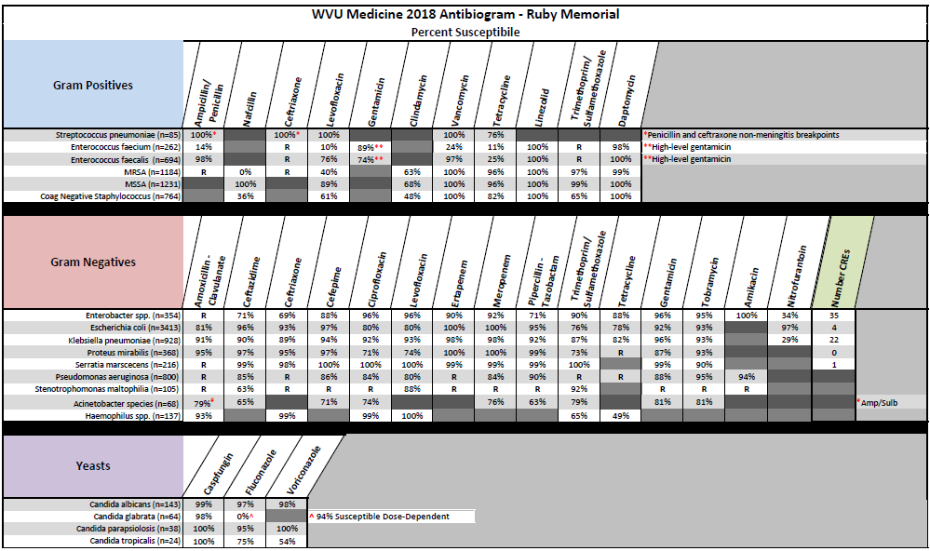

Slide 38
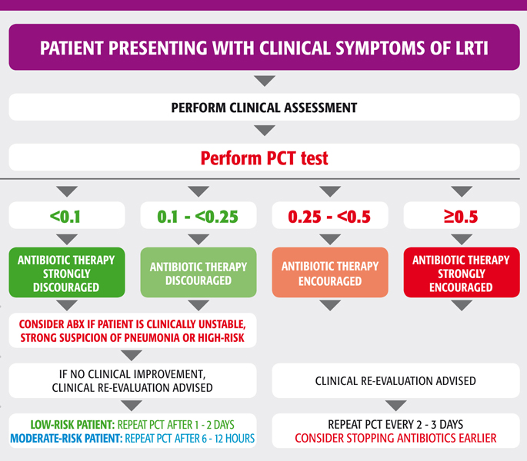
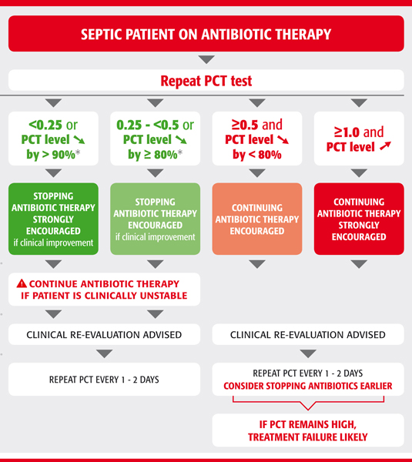
Laboratory – Procalcitonin algorithms

Slide 39
Our Team
All of you !!!
Things you can do day to day as Residents:
  Pay attention to the Pop-up alerts
  Read ordering instructions (at least once ☺)
  Use the Antibiotic Guidance link on EPIC routinely
    empiric treatment, duration, etc.
  Utilize Microbiology lab / Diagnostic tests / Procal trend
  Clarify antibiotic allergies (esp. B-lactams)
  CALL TRANSFERING HOSPITALS MICRO LAB
  QUESTIONS????

Slide 40
