Slide 1
VS CoBRE
Visual Function and Morphology Core

Slide 2
Visual Function and Morphology Core:
Equipment Available
  LKC and Celeris Electoretinography (ERG) Systems
  JEOL Transmission Electron Microscope 1400
  OptoMotry Optokinetic Response (OKR) System
  SIM and STORM Super-resolution Microscopes
  Olympus Slide Scanner
  Optical Coherence Tomography (OCT) System
  Vevo Ultrasound System
  Zeiss and Nikon AXR Confocal Microscopes
  Cryostat
  Vibratome & Ultramicrotome
  Leica UC7 Ultramicrotome
  Image analysis workstation
  Phoenix-Micron 5

Slide 3
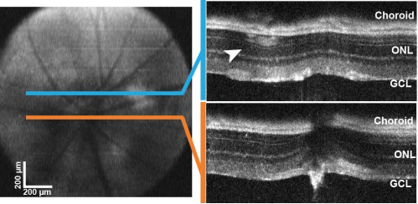
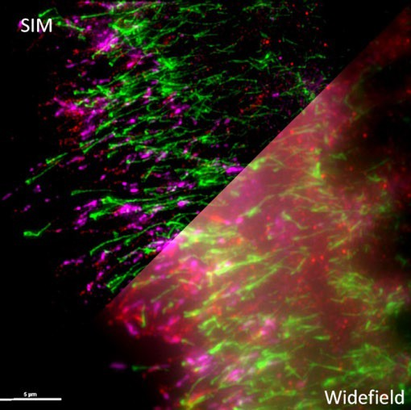
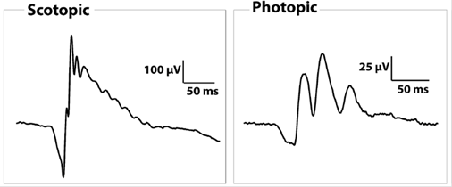
Visual Function and Morphology Core:
Comparison of SIM super resolution to standard confocal microscopy
OCT measurements of retinal thickness
ERG measurements of retinal function

Slide 4
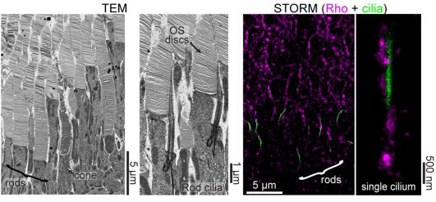
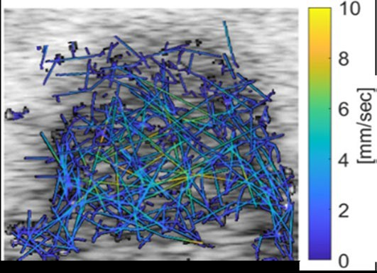
Visual Function and Morphology Core:
Retinal blood flow tracing using microbubble contrast agent and the Vevo Ultrasound
Transmission electron and super resolution light microscopy of photoreceptor cell layer

