Slide 1

Navigating Applications
Presented by
Victoria Paz,
Office Manager
Graduate Medical Education
There is a link to this slide
deck at the end of the presentation

Slide 2
Your portal to accessing MOST applications at WVUMedicine:
CONNECT
https://connect.wvumedicine.org/
Note: you must be connected to the network to access the site

Slide 3
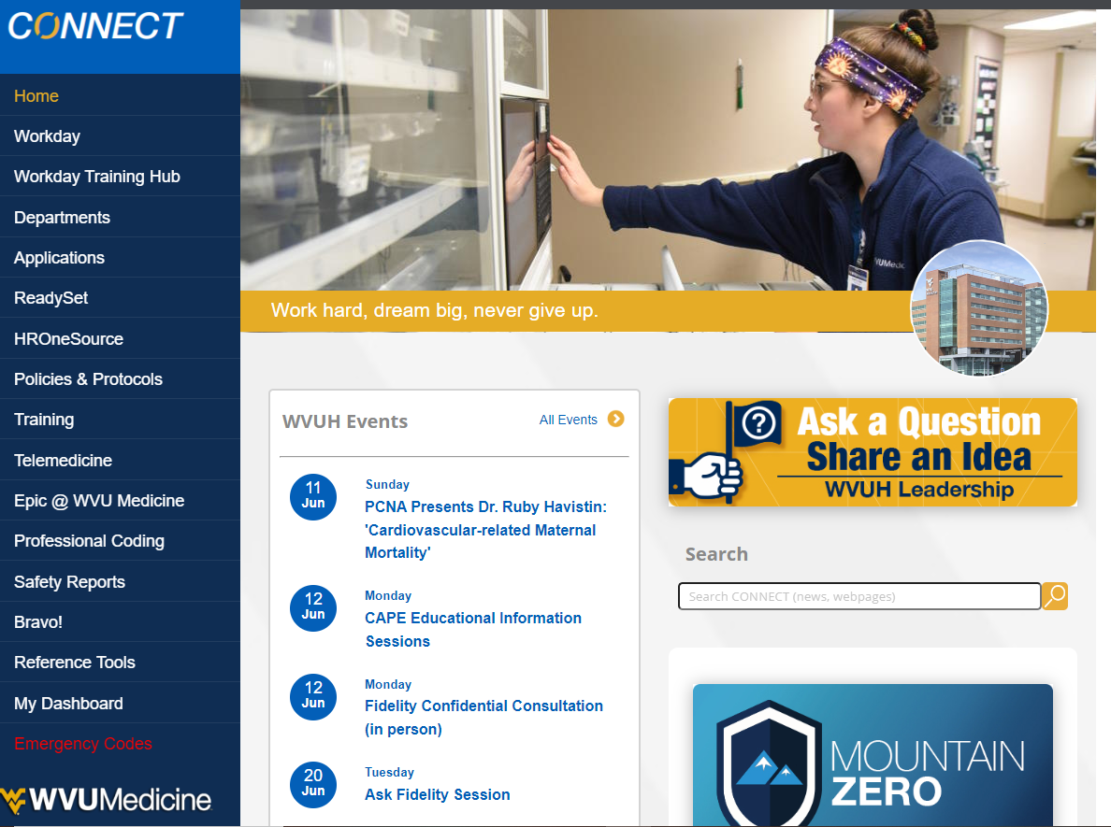
connect.wvumedicine.org

Slide 4
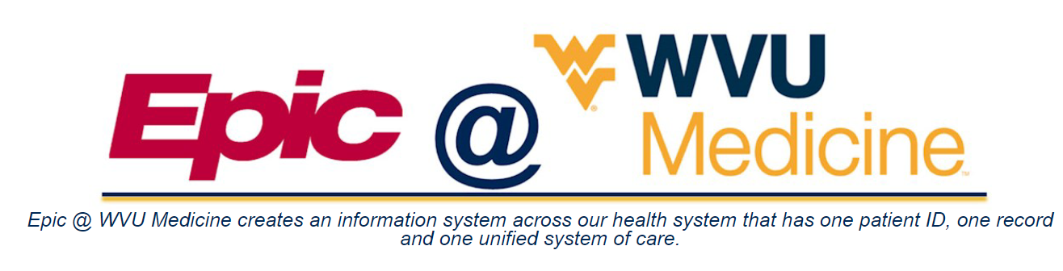
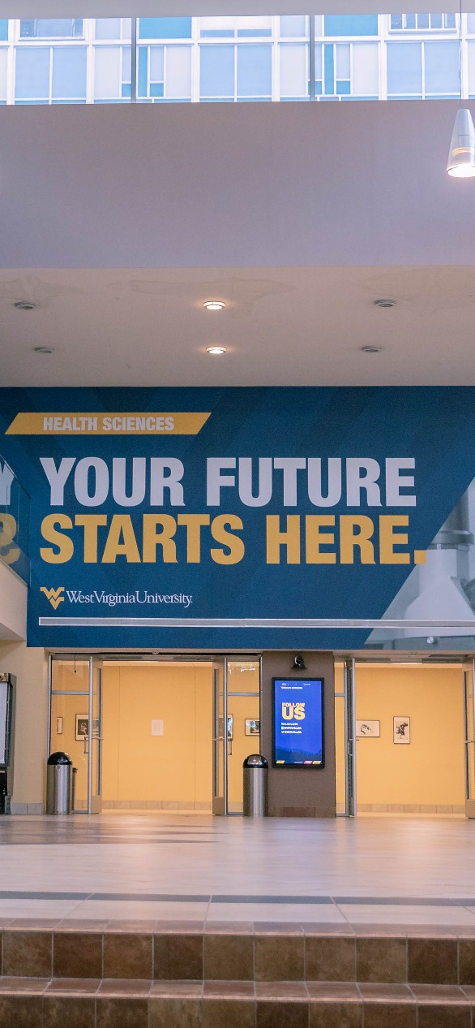
Access via CONNECT >>
Epic @ WVUMedicine
Epic @ WVUMedicine allows for one patient ID, one record and one unified system of care across system health locations
Need help with Epic? Visit the website: https://connect.wvumedicine.org/epic-wvu-medicine/

Slide 5

Epic Training
Epic training is required according to hospital policy before a resident or fellow can start clinical training. Some providers may need training on more than one application.
  Speak to your Program Manager about scheduling for training
  Digital e-Learning courses for Epic training are available in Workday
  Log In Labs available at the IT Service Desk 4th Floor Ruby
Epic is the correct environment to access patient info and documentation. More information about other environments is contained in the “Epic Provider Training Handout”.
Questions concerning Epic: contact epicprovidertraining@wvumedicine.org
Direct any log in issues to the Help Desk

Slide 6

Clinical Epic Help Desk
304-598-HELP (4357) Option 2
Available: 7 am to 5 pm; Monday through Friday, excluding holidays
Clinical Help Desk is intended for physicians, advanced practice providers (APPs), clinical staff, or employees calling on behalf of a provider
Clinical Help Desk is designed to help with workflow issues and problems that occur after providers have logged into Epic
To reach the Clinical Help Desk, call 304-598-HELP (4357) and press 2 when the automated recording answers
Note that all password or login issues should go to the IT Technical Help Desk
If you need technical assistance for log in or password issues, call 304-598-HELP and press option 1.

Slide 7


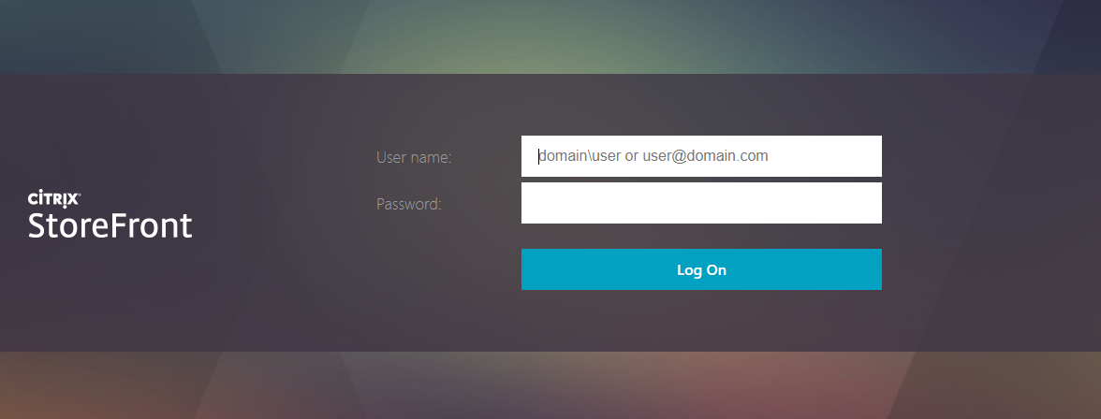
Access via CONNECT >> Applications >> Citrix
Citrix is the hospital’s designated remote access application and is required to access Epic when working off site
Need help with Citrix? Contact the WVU Medicine IT Help Desk (304-598-4357) or submit an IT Ticket

Slide 8

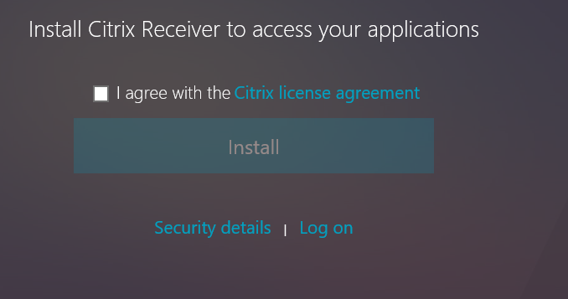
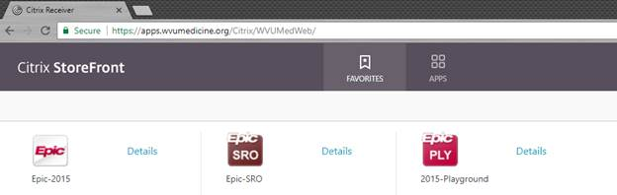
Remote Epic Access via Citrix
Imprivata ID MUST be downloaded on your phone to access Citrix, this allows for two factor authentication.
Search for https://apps.wvumedicine.org
Install or save as a favorite
  To install, click agree and then install
Enter Username (email or Epic login) and Password to login
  You will then be prompted by Imprivata on your phone to approve this login.
Click on desired application. Contact the help desk if your desired application is not available under the apps menu.
Notes:
MAC?

Slide 9
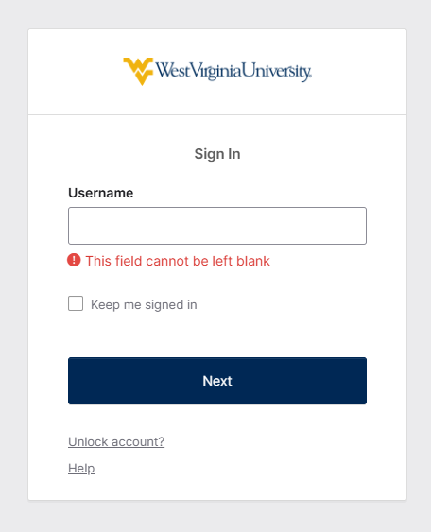


Two-factor authentication for WVU applications is Okta
Need help with Okta?
Contact: Create an IT ticket
https://wvu.atlassian.net/servicedesk/customer/portals

Slide 10
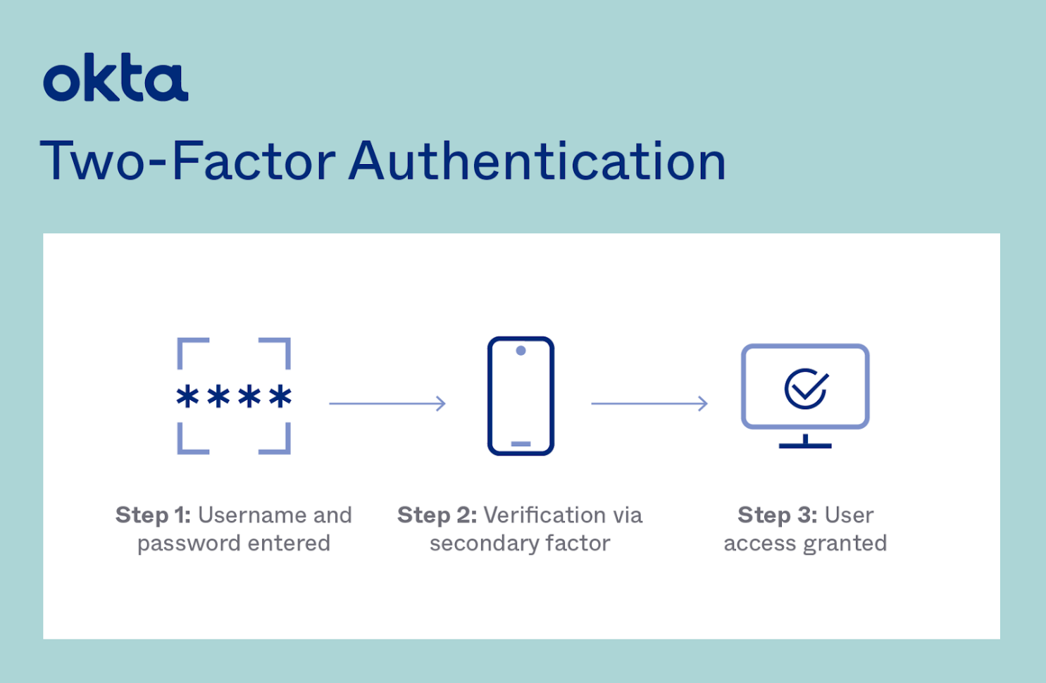
Download the Okta app on your cellphone to complete two-factor authentication when logging in to WVU applications

Slide 11


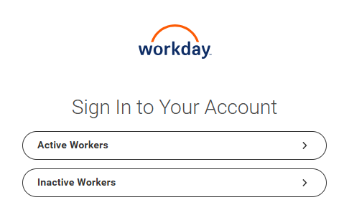
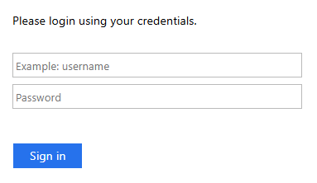
Access via CONNECT >> Workday
Workday provides instant access to important tasks and actions including CBLs within the Learning tab
Need help with Workday?
Visit: https://www.myworkday.com/wvumedicine/wdhelp/helpcenter

Slide 12
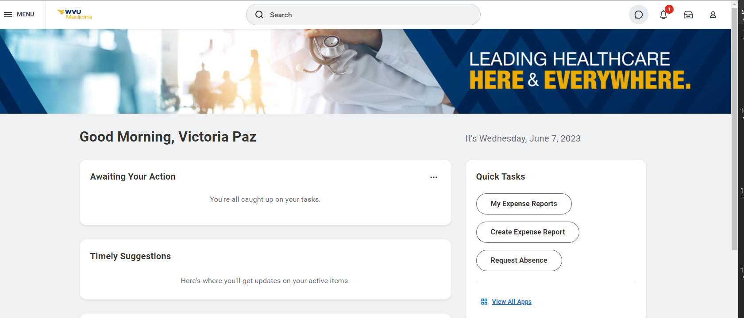
Workday

Slide 13

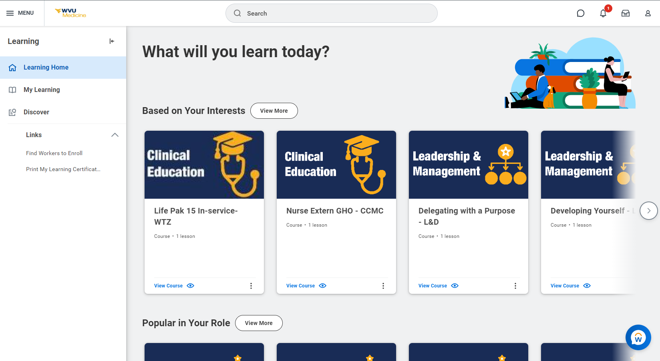
Workday

Slide 14

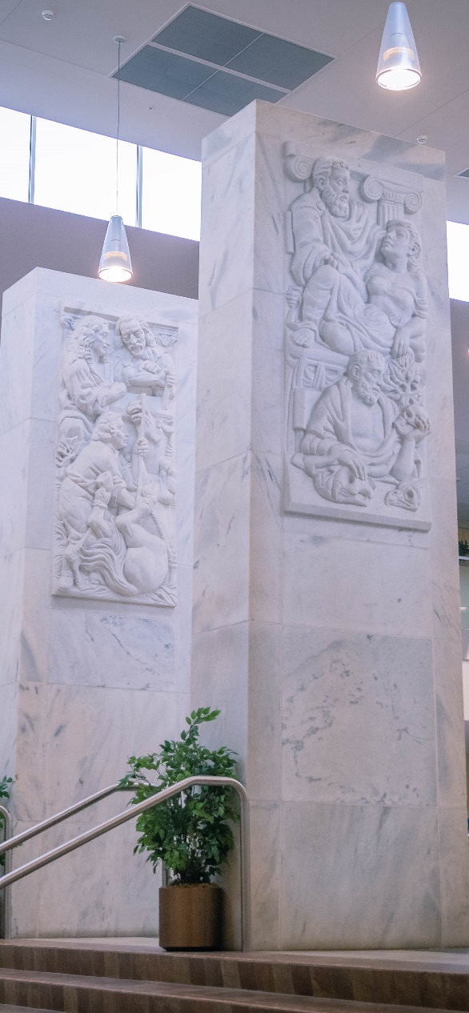
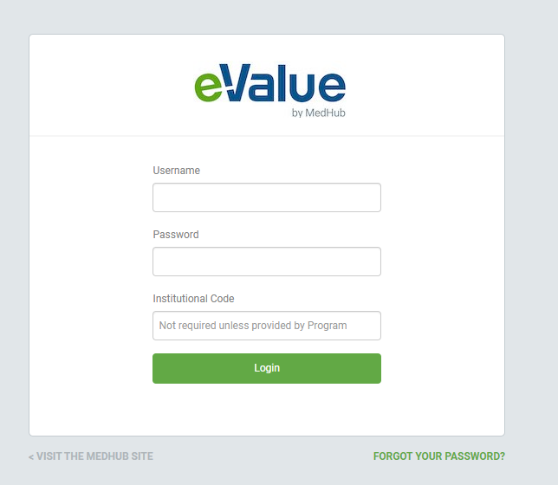
Access via https://www.e-value.net/login.cfm
eValue is the GME evaluation system for residents and a repository for residency program specific information, including personal records and a program portfolio (our electronic file cabinet)
Need help with eValue?
Contact: your Program Manager

Slide 15

MedHub Email Notifications
eValue is designed to send notifications to your WVUMedicine email account regarding requirements that are approaching expiration, including but not limited to Duty Hours, ACLS/PALS certification, and DS‑2019 renewals
Did you get a MedHub email alert?
Contact: your Program Manager

Slide 16



Access via https://sole.hsc.wvu.edu/
SOLE is the informational resource site for GME (our electronic library)
Need help with SOLE?
Contact: solesupport@hsc.wvu.edu

Slide 17

Victoria Paz, GME Office Manager
  victoria.paz@hsc.wvu.edu
  304-293-0672
  Graduate Medical Education
  First Floor HSC
  1144 HSC-North
  PO Box 9001 A
  GME office is located next to the Pharmacy Museum & Student Services

Slide 18
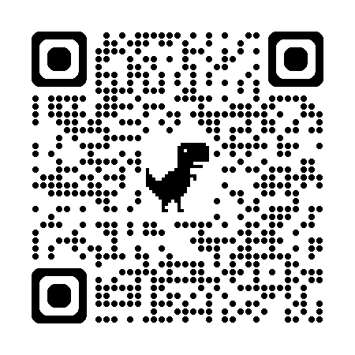

Visit the GME website for more information about our programs and people. Welcome to the team!
SCAN QR code NOW
Scroll down the webpage and click on link for:
  Navigating Applications

